Slide 1
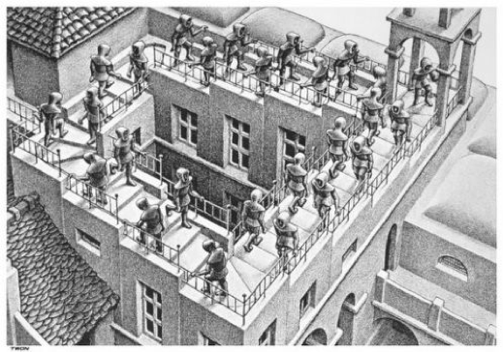





The Complexity of the Cosmos: A possible path to make the Universe Simple
Raul Jimenez

Slide 2
In this talk we propose two possible quantum signatures of the gravitons at early Universe that could lead to observational imprints of the quantum nature of the inflationary period:
1). In “An Entangled Universe,” Tejerina-Pérez, Daniele Bertacca, Raul Jimenez, 2403.15742,
In this paper we consider
- a graviton production from the presence of a classical, coherent state of the inflaton scalar field results in entangled states in the gravitons’ polarizations.
At horizon crossing, interactions between the gravitons and (lower scale) inflatons, together with the gathering of “which-path information” from the cosmological horizon, perform the required Bell experiments leading to a definitive measure.
This measure can be imprinted in the scalar correlation four-point function. This is because of a non-trivial eﬀect due to the derivatives on two scalar fluctuations.
This scalar fluctuations provides a fingerprint that depends on the polarization of the graviton that Alice and/or Bob measured in their patch.

Slide 3
In this talk we propose two possible quantum signatures of the gravitons at early Universe that could lead to observational imprints of the quantum nature of the inflationary period:
In “Inflation without an Inflaton,” Daniele Bertacca, Raul Jimenez, Matarrese & Ricciardone, 2412.14265:
We propose a novel scenario in which scalar perturbations, that seed the large-scale structure of the Universe, are generated without relying on a scalar field (the inflaton).
In this framework, inflation is driven by a de Sitter space-time (dS), where tensor metric fluctuations (i.e., gravitational waves) naturally arise from quantum vacuum oscillations, and scalar fluctuations are generated via second-order tensor eﬀects.

Slide 4
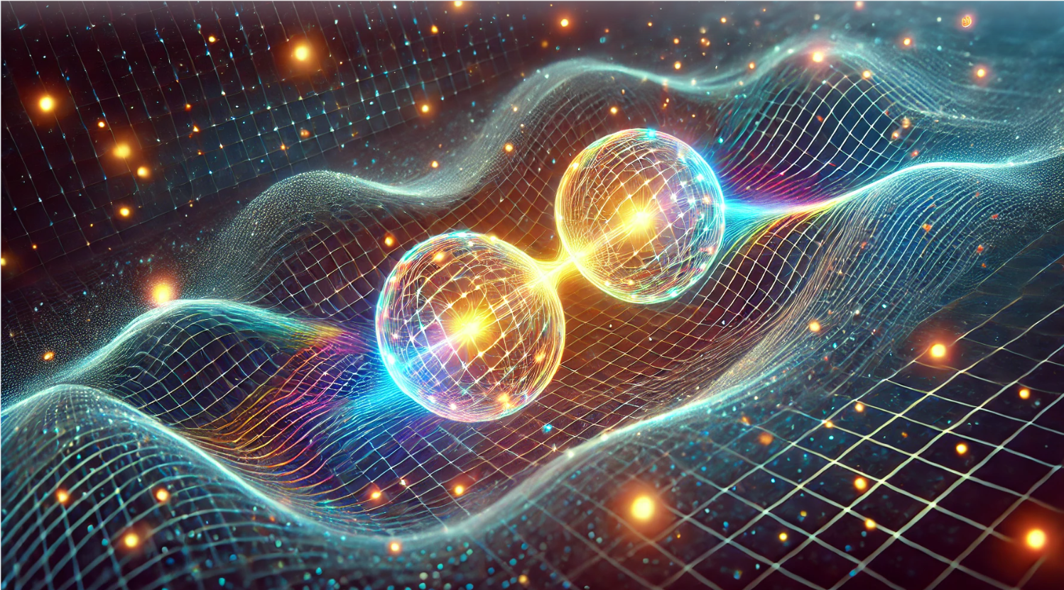
An Entangled Universe
Project by:
Pablo Tejerina-Pérez, Daniele Bertacca, Raul Jiménez

Slide 5



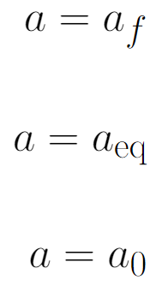


Inflation (general)
Scalar field – Scalar perturbations
Quasi - de Sitter metric – Tensor perturbations
$$H_{Λ}^{−1}$$
$$φ$$
Quantum fluctuations in the fields present during inflation (in its most minimal form, just the spacetime-metric field, and a scalar field called the inflaton) get stretched by the exponential expansion to cosmological distances.
Inflation
Radiation

Slide 6
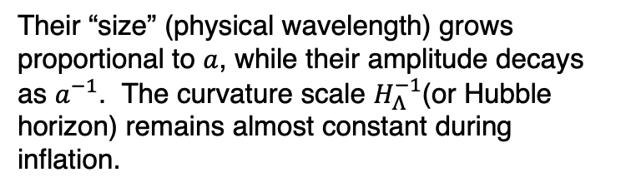
Inflation (general)
Scalar field – Scalar perturbations
Quasi - de Sitter metric – Tensor perturbations
$$H_{Λ}^{−1}$$
$$φ$$
Their “size” (physical wavelength) grows proportional to $a$, while their amplitude decays as $a^{−1}$. The curvature scale $H_{Λ}^{−1}$(or Hubble horizon) remains almost constant during inflation.
Inflation
Radiation

Slide 7
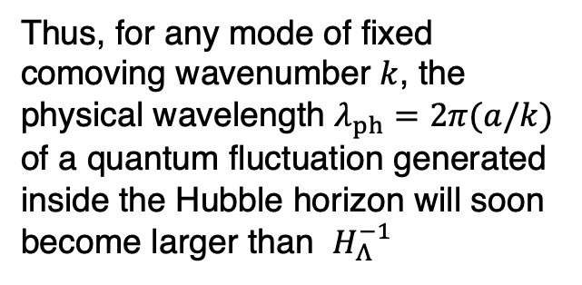
Inflation (general)
Scalar field – Scalar perturbations
Quasi - de Sitter metric – Tensor perturbations
$$H_{Λ}^{−1}$$
$$φ$$
Thus, for any mode of fixed comoving wavenumber $k$, the physical wavelength $λ_{ph}=2π(a/k)$ of a quantum fluctuation generated inside the Hubble horizon will soon become larger than $H_{Λ}^{−1}$
Inflation
Radiation
Therefore, the corresponding mode leaves the horizon, and starts “feeling” the curvature of spacetime.
At horizon crossing, its amplitude freezes and remains almost constant until the end of the inflationary stage.

Slide 8
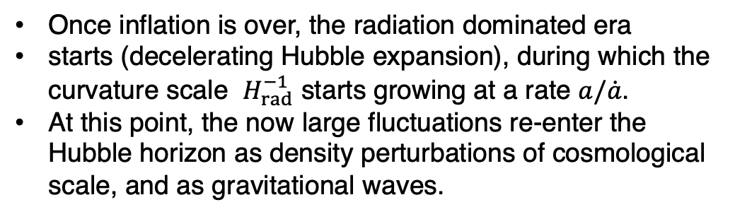

Inflation (general)
$$H_{Λ}^{−1}$$
Radiation epoch
Once inflation is over, the radiation dominated era
starts (decelerating Hubble expansion), during which the curvature scale $H_{rad}^{−1}$ starts growing at a rate $a/\dot{a}$.
At this point, the now large fluctuations re-enter the Hubble horizon as density perturbations of cosmological scale, and as gravitational waves.
Inflation
Radiation

Slide 9
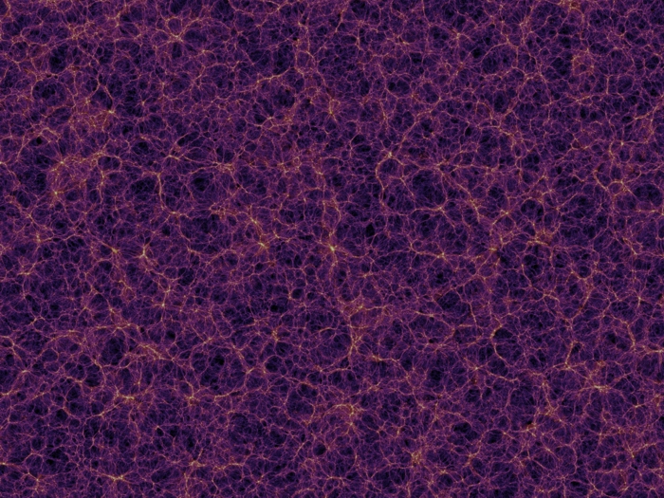
Inflation (general)
$$H_{Λ}^{−1}$$
These density perturbations work as classical gravitational seeds for the formation of large-scale structures.
Modes that left the horizon the latest will be the first ones to reenter, and vice-versa.
For the modes of cosmological interest, i.e. those responsible for the observed large-scale structure of the Universe (between 1 Mpc and 3000 Mpc approximately), the moment of horizon crossing should be early enough1, so that they re-enter around the present observable large scale today.
Gravitational seeds for LSS
Inflation
Radiation

Slide 10
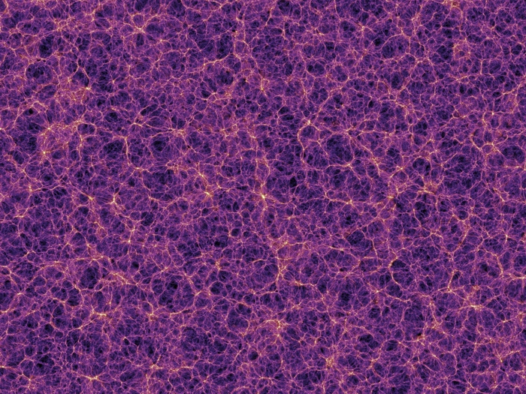
Inflation (general)
$$H_{Λ}^{−1}$$
These density perturbations work as classical gravitational seeds for the formation of large-scale structures.
Modes that left the horizon the latest will be the first ones to reenter, and vice-versa.
For the modes of cosmological interest, i.e. those responsible for the observed large-scale structure of the Universe (between 1 Mpc and 3000 Mpc approximately), the moment of horizon crossing should be early enough1, so that they re-enter around the present observable large scale today.
Gravitational seeds for LSS
Therefore, Inflation introduces a natural way to explain the inhomogeneities and anisotropies in the Universe that gave rise to the formation of the cosmological structures we observe today.
Inflation
Radiation

Slide 11
Motivations
We treat this perturbations as classical:
When did the quantum-to-classical transition occur?
Can we find some trace of the initial quantumness?
In this context, there is a somewhat natural question that emerges: at what point does a quantum fluctuation generated during inflation stop being of quantum nature?

Slide 12
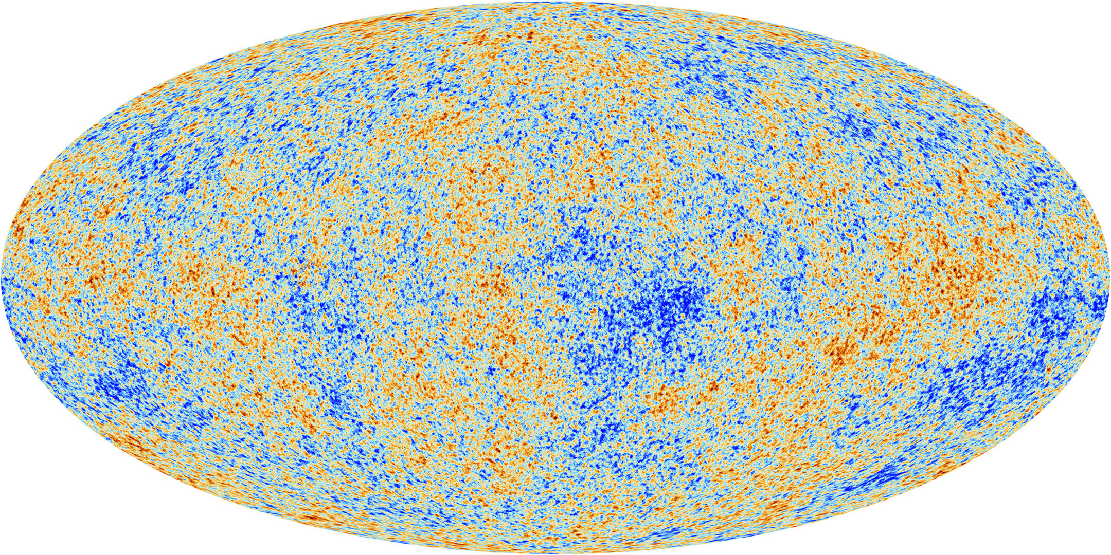
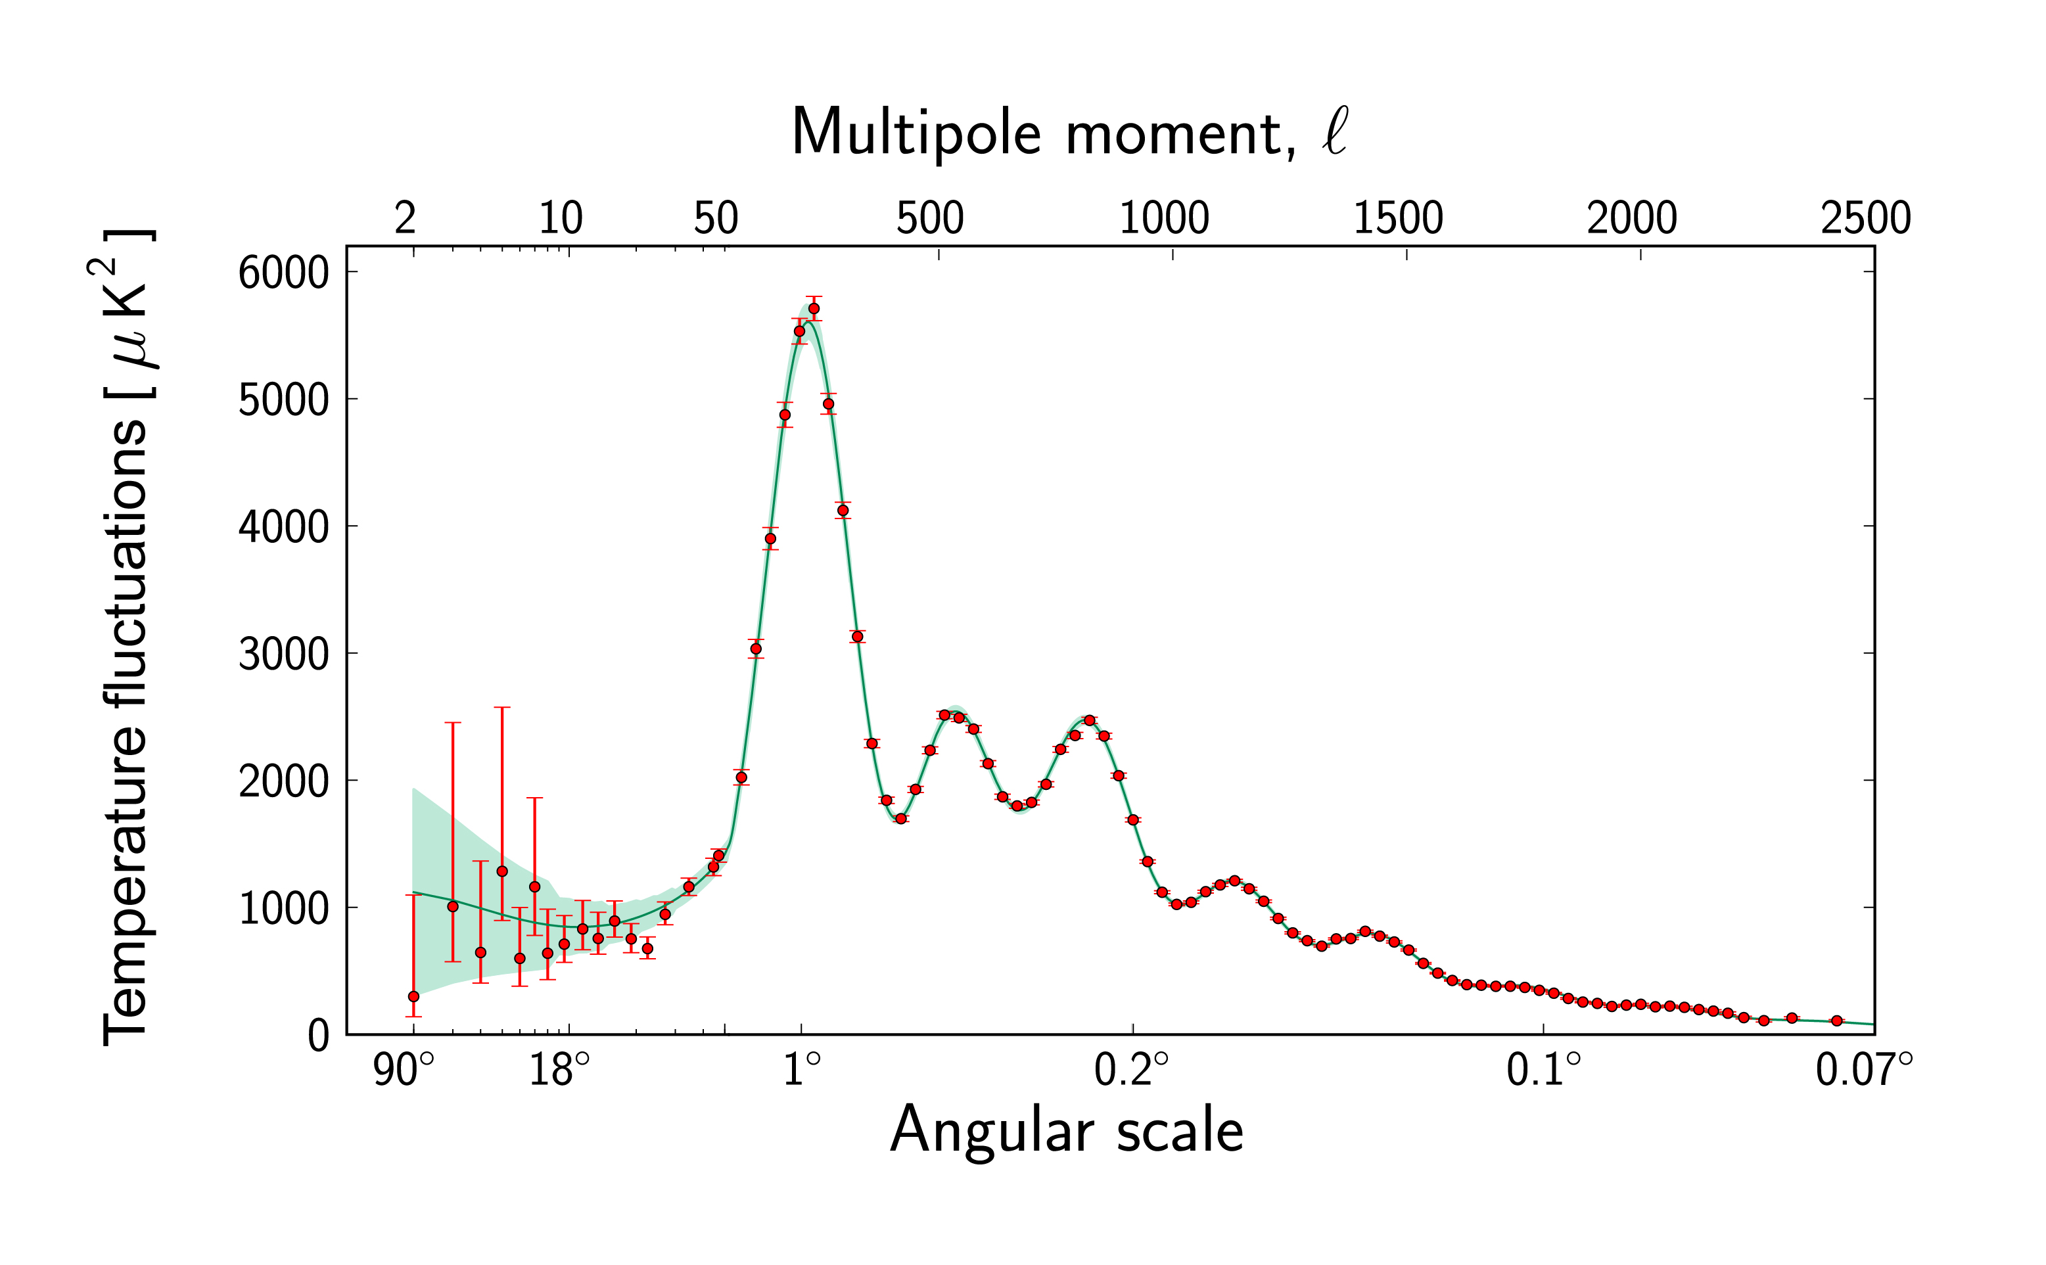
Motivations
We treat this perturbations as classical:
When did the quantum-to-classical transition occur?
Can we find some trace of the initial quantumness?
In this context, there is a somewhat natural question that emerges: at what point does a quantum fluctuation generated during inflation stop being of quantum nature?
The analysis that we apply to the Cosmic Microwave Background (CMB), which provides us with the earliest observational features of the Universe so far, and to large scale structure survey’s data, is classical.
But where did the quantum nature of the gravitational seeds go?

Slide 13
Motivations
We treat this perturbations as classical:
When did the quantum-to-classical transition occur?
Can we find some trace of the initial quantumness?
In this context, there is a somewhat natural question that emerges: at what point does a quantum fluctuation generated during inflation stop being of quantum nature?
The analysis that we apply to the Cosmic Microwave Background (CMB), which provides us with the earliest observational features of the Universe so far, and to large scale structure survey’s data, is classical.
But where did the quantum nature of the gravitational seeds go?
It is still an open question how this classicalization of quantum fluctuations occurs.
If any signal of the early nature of the quantum fluctuation remains, this should be imprinted in some current observable, maybe in the form of non-gaussianities in the CMB anisotropies, or in higher-order correlation functions of galaxy distributions, or some other observable.

Slide 14
How we can make creation of an entangled state of gravitons generated during inflation
We introduce the relevant Hamiltonian for the creation of an entangled state of gravitons.

Slide 15
How we can make creation of an entangled state of gravitons generated during inflation
We introduce the relevant Hamiltonian for the creation of an entangled state of gravitons.
We suggest a mechanism by which entangled states are created during inflation, via the interaction of gravitons and an inflaton in a classical, coherent state, such that it acts as a “pump” field.

Slide 16
How we can make creation of an entangled state of gravitons generated during inflation
We introduce the relevant Hamiltonian for the creation of an entangled state of gravitons.
We suggest a mechanism by which entangled states are created during inflation, via the interaction of gravitons and an inflaton in a classical, coherent state, such that it acts as a “pump” field.
Then, we describe plausible processes by which the quantum nature of the tensor fluctuations of the metric field (i.e. gravitons) during inflation is made explicit.

Slide 17
How we can make creation of an entangled state of gravitons generated during inflation
We introduce the relevant Hamiltonian for the creation of an entangled state of gravitons.
We suggest a mechanism by which entangled states are created during inflation, via the interaction of gravitons and an inflaton in a classical, coherent state, such that it acts as a “pump” field.
Then, we describe plausible processes by which the quantum nature of the tensor fluctuations of the metric field (i.e. gravitons) during inflation is made explicit.
We study how, through interaction with their environment, gravitons may imprint this quantumness into some observable quantity.
We then propose what this observable quantity might be.

Slide 18
Entanglement as a quantum property
Let me briefly review what is known to be the “most quantum aspect” in quantum mechanics and quantum optics: entanglement.
This effect makes the quantum nature of a system appear in a very explicit manner; if we are hoping to find traces of quantumness in some observable, entanglement is what we should aim for.

Slide 19
Entanglement as a quantum property
Entanglement between two quantum states is present when the quantum state describing the whole system cannot be written as a product of the states describing each subsystem separately, i.e. it is non-separable.
Entanglement is exclusively a consequence of the principle of superposition present in quantum mechanics and makes the non-locality of the theory explicit.

Slide 20

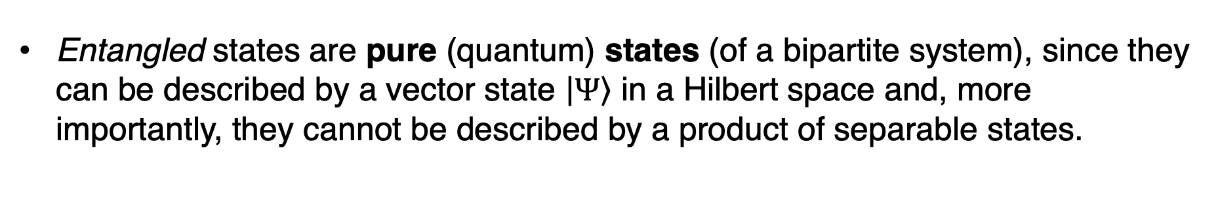
Entanglement as a quantum property
Entangled states are pure (quantum) states (of a bipartite system), since they can be described by a vector state $\left|\left.Ψ\right\rangle \right.$ in a Hilbert space and, more importantly, they cannot be described by a product of separable states.

Slide 21
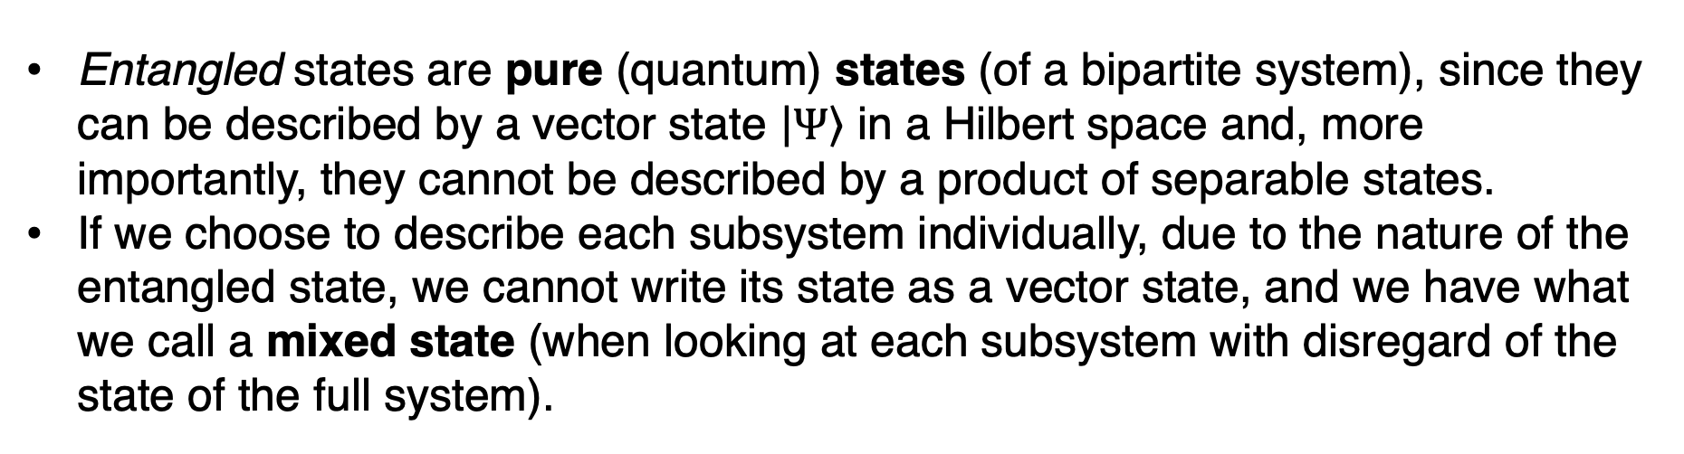
Entanglement as a quantum property
Entangled states are pure (quantum) states (of a bipartite system), since they can be described by a vector state $\left|\left.Ψ\right\rangle \right.$ in a Hilbert space and, more importantly, they cannot be described by a product of separable states.
If we choose to describe each subsystem individually, due to the nature of the entangled state, we cannot write its state as a vector state, and we have what we call a mixed state (when looking at each subsystem with disregard of the state of the full system).

Slide 22
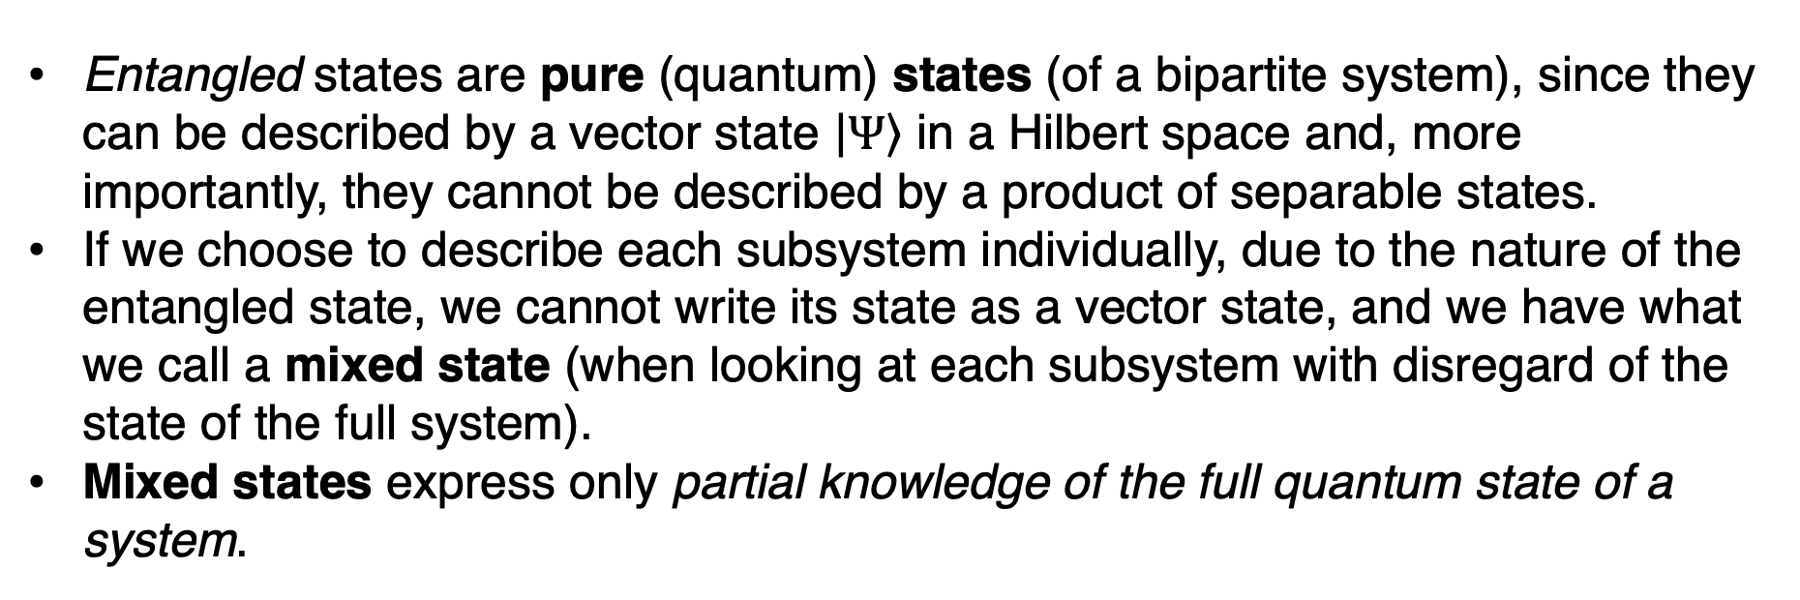
Entanglement as a quantum property
Entangled states are pure (quantum) states (of a bipartite system), since they can be described by a vector state $\left|\left.Ψ\right\rangle \right.$ in a Hilbert space and, more importantly, they cannot be described by a product of separable states.
If we choose to describe each subsystem individually, due to the nature of the entangled state, we cannot write its state as a vector state, and we have what we call a mixed state (when looking at each subsystem with disregard of the state of the full system).
Mixed states express only partial knowledge of the full quantum state of a system.

Slide 23
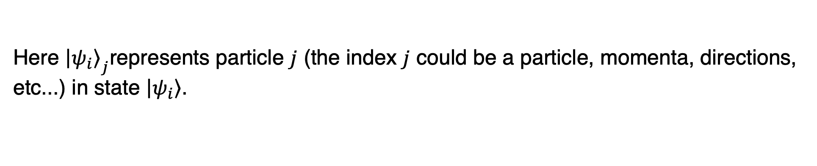
Entanglement as a quantum property
A
B
Here ${\left|\left.ψ_{i}\right\rangle \right.}_{j}$represents particle $j$ (the index $j$ could be a particle, momenta, directions, etc...) in state $\left|\left.ψ_{i}\right\rangle \right.$.

Slide 24
Entanglement as a quantum property
A
B

Slide 25

Entanglement as a quantum property
A
B

Slide 26
Entanglement as a quantum property
A
B

Slide 27
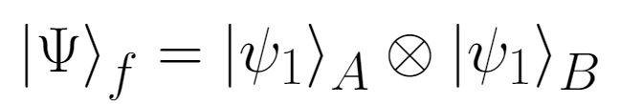
Entanglement as a quantum property
A
B

Slide 28
Entanglement as a quantum property
A
B
By performing a measure on one particle, we instantaneously change the state of the other!

Slide 29
Bell Experiment and Inequalities
In 1964, the physicist John Stewart Bell proposed his famous theorem, which showed a clear mathematical difference between any description by a classical, local hidden variables theory, or by the quantum-mechanical theory that gave rise to the non-local effect of the entanglement.
Extensive work has been done over the years concerning all theoretical and experimental aspects of Bell’s theorem and experiment [e.g. see Clauser + (1969), Shimony & Clauser (1978)].

Slide 30
Bell Experiment and Inequalities
Here, we are interested in replicating each of the needed elements of the Bell experiment in our inflationary paradigm. These elements are Juan Maldacena (2015):

Slide 31
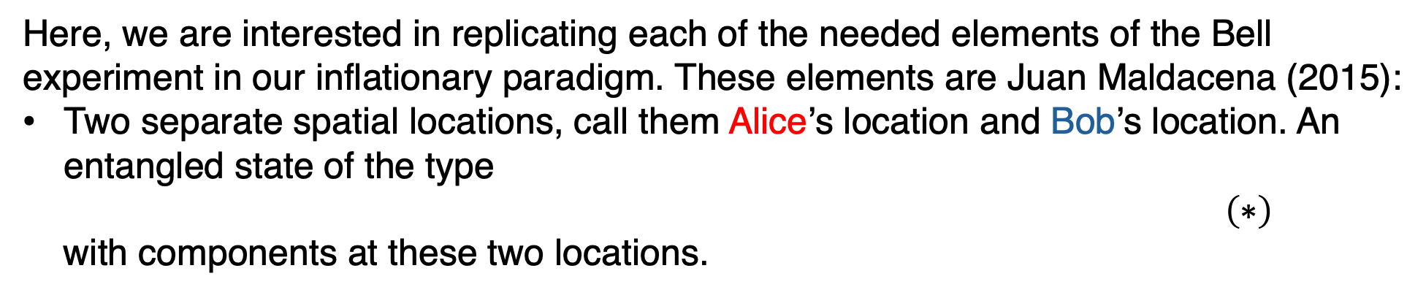
Bell Experiment and Inequalities
Here, we are interested in replicating each of the needed elements of the Bell experiment in our inflationary paradigm. These elements are Juan Maldacena (2015):
Two separate spatial locations, call them Alice’s location and Bob’s location. An entangled state of the type
$\left(∗\right)$
with components at these two locations.

Slide 32
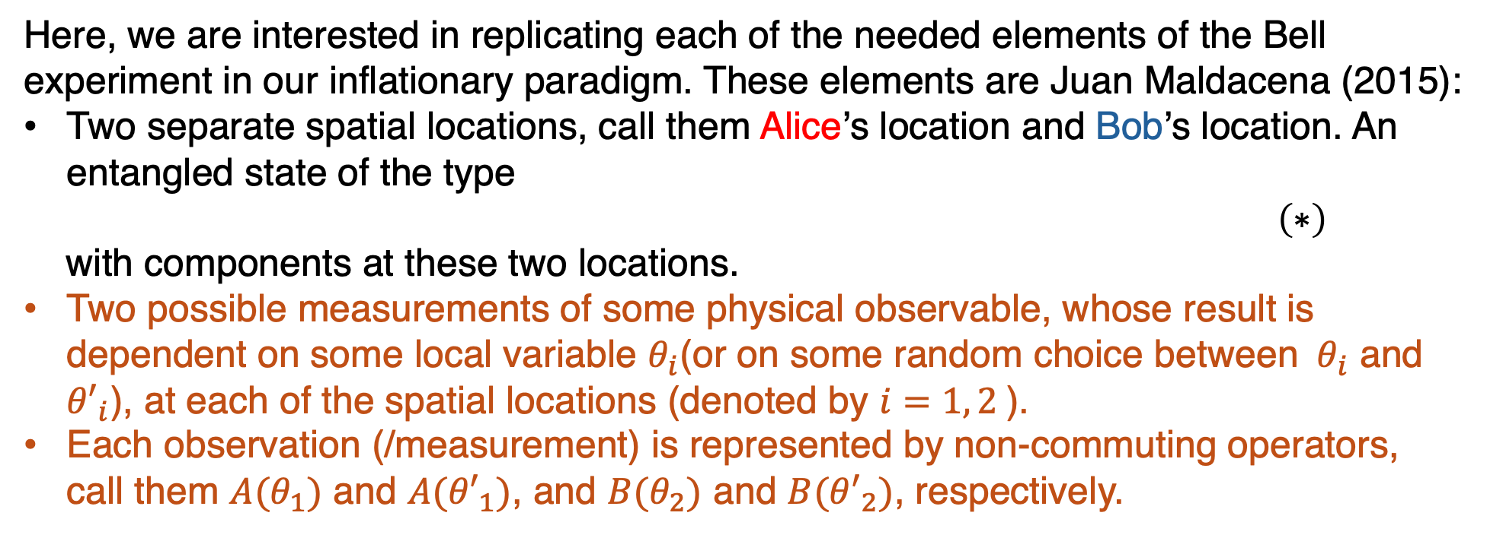
Bell Experiment and Inequalities
Here, we are interested in replicating each of the needed elements of the Bell experiment in our inflationary paradigm. These elements are Juan Maldacena (2015):
Two separate spatial locations, call them Alice’s location and Bob’s location. An entangled state of the type
$\left(∗\right)$
with components at these two locations.
Two possible measurements of some physical observable, whose result is dependent on some local variable $θ_{i}$(or on some random choice between $θ_{i}$ and ${θ′}_{i}$), at each of the spatial locations (denoted by $i=1, 2$).
Each observation (/measurement) is represented by non-commuting operators, call them $A(θ_{1})$ and $A({θ′}_{1})$, and $B(θ_{2})$ and $B({θ′}_{2})$, respectively.

Slide 33

Bell Experiment and Inequalities
Then we can define the observable:
where

Slide 34
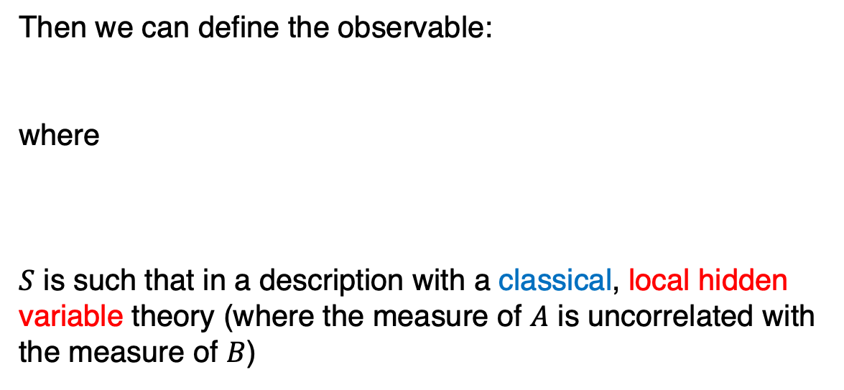
Bell Experiment and Inequalities
Then we can define the observable:
where
$S$ is such that in a description with a classical, local hidden variable theory (where the measure of $A$ is uncorrelated with the measure of $B$)

Slide 35
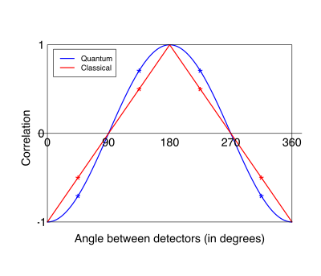
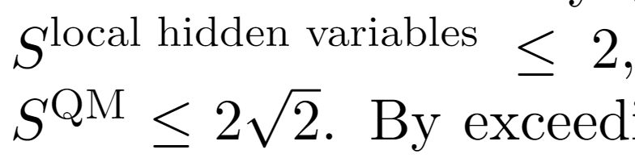

Bell Experiment and Inequalities
Then we can define the observable:
where
$S$ is such that in a description with a classical, local hidden variable theory (where the measure of $A$ is uncorrelated with the measure of $B$):

Slide 36
Bell Experiment and Inequalities
Then we can define the observable:
where
$S$ is such that in a description with a classical, local hidden variable theory (where the measure of $A$ is uncorrelated with the measure of $B$):
By exceeding the former inequality in experimental measures, one proves the non-locality as an intrinsic property of entanglement and quantum mechanics.
This particular Bell inequality is known as the Clauser-Horne-Shimony-Holt inequality, see Clauser + (1969)

Slide 37
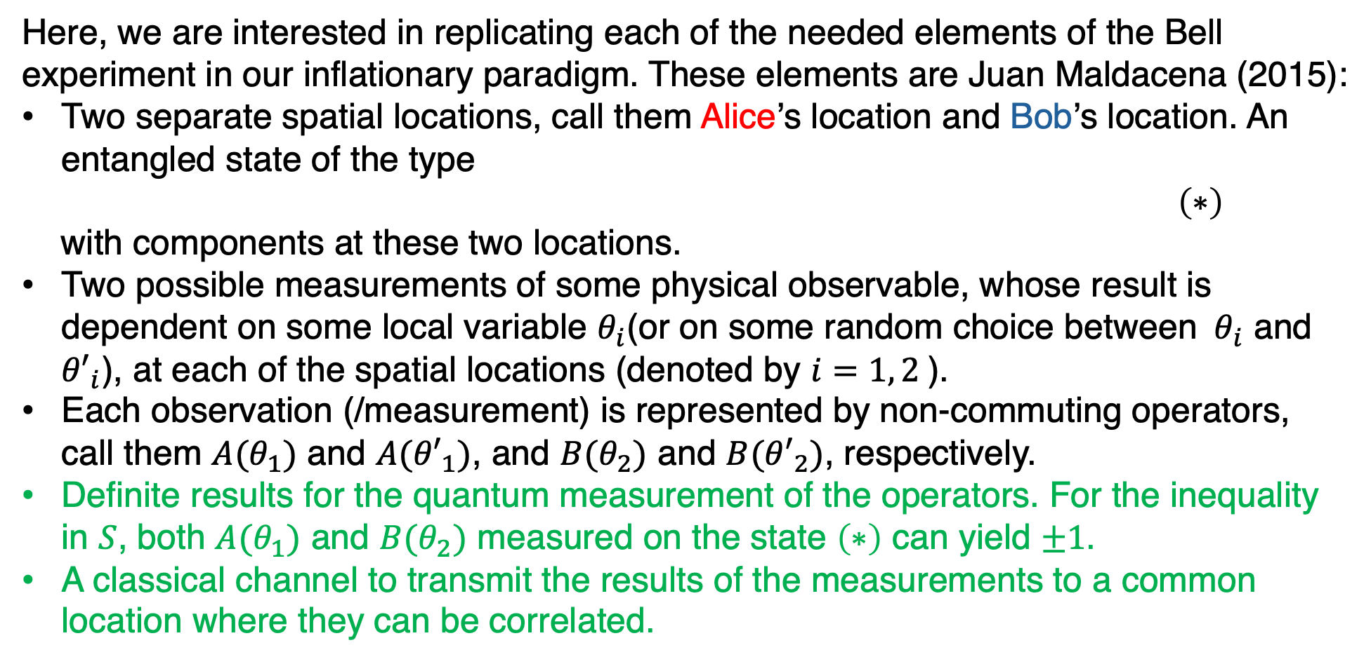
Bell Experiment and Inequalities
Here, we are interested in replicating each of the needed elements of the Bell experiment in our inflationary paradigm. These elements are Juan Maldacena (2015):
Two separate spatial locations, call them Alice’s location and Bob’s location. An entangled state of the type
$\left(∗\right)$
with components at these two locations.
Two possible measurements of some physical observable, whose result is dependent on some local variable $θ_{i}$(or on some random choice between $θ_{i}$ and ${θ′}_{i}$), at each of the spatial locations (denoted by $i=1, 2$).
Each observation (/measurement) is represented by non-commuting operators, call them $A(θ_{1})$ and $A({θ′}_{1})$, and $B(θ_{2})$ and $B({θ′}_{2})$, respectively.
Definite results for the quantum measurement of the operators. For the inequality in $S$, both $A(θ_{1})$ and $B(θ_{2})$ measured on the state $\left(∗\right)$ can yield $±1$.
A classical channel to transmit the results of the measurements to a common location where they can be correlated.

Slide 38
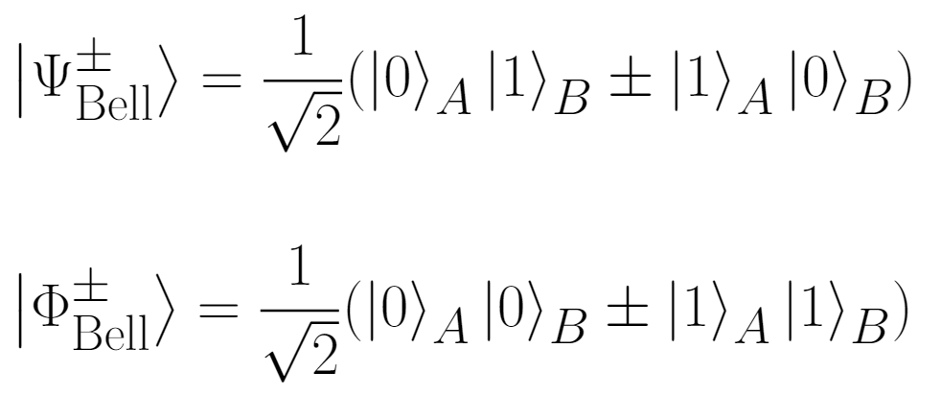
Bell Experiment and Inequalities
It is useful to work with 2-states known as Bell states, which are defined as
As we will see later, let us cosider these Bell states

Slide 39


Elements of a Bell experiment
A
B

Slide 40
Elements of a Bell experiment

Slide 41
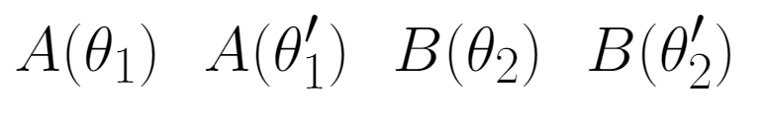
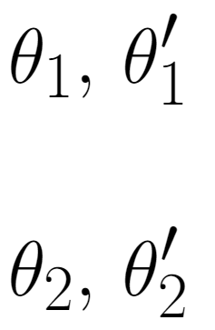
Elements of a Bell experiment
Local choice
Local choice

Slide 42
Elements of a Bell experiment
Local choice
Final Observer
Local choice

Slide 43

Elements of a Bell experiment
Local choice
Final Observer
Local choice

Slide 44
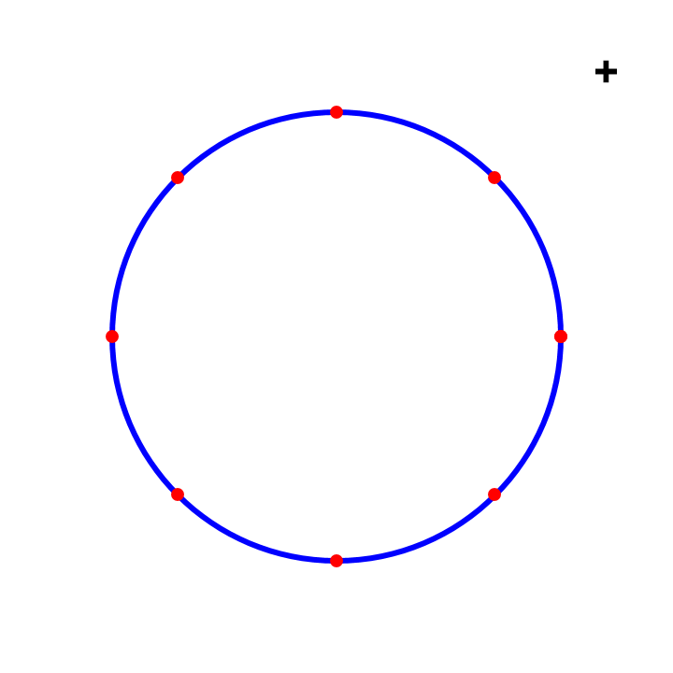
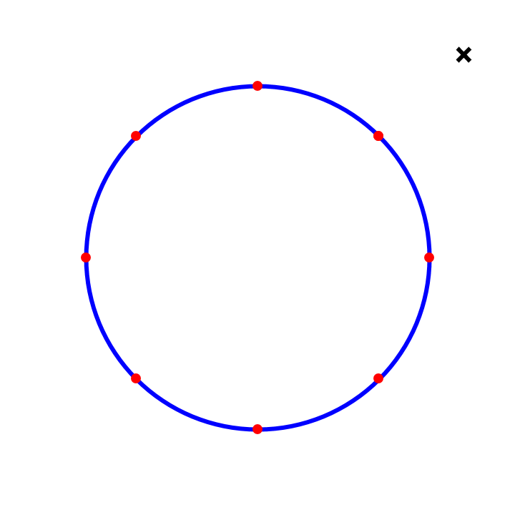
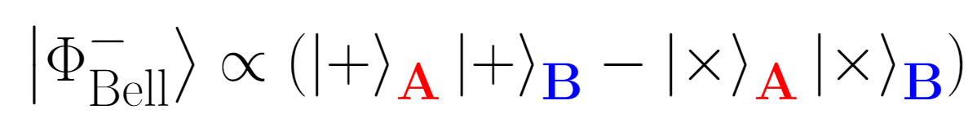


Entangled state of gravitons
Observable with discrete spectrum – tensor polarizations: $+, ×$
$$−$$

Slide 45
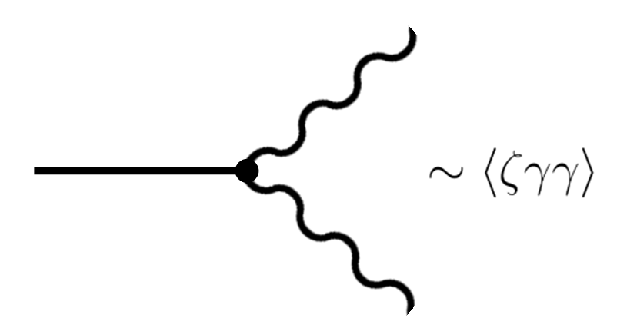
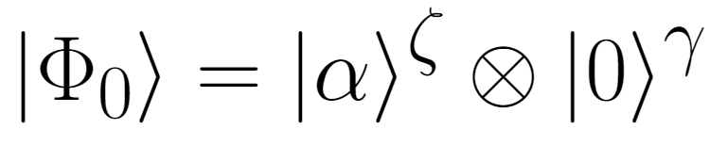
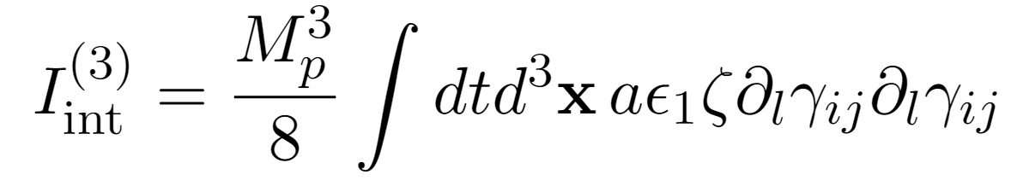
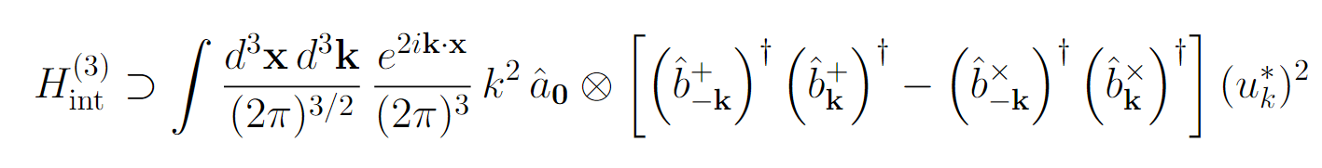
Entangled state of gravitons
We assume a coherent, classical state for the inflaton field at an early stage of inflation – “pump” field:
Action to 3rd order in perturbations:

Slide 46
Entangled state of gravitons
We assume a coherent, classical state for the inflaton field at an early stage of inflation – “pump” field:
A
Action to 3rd order in perturbations:
B
A
B
A
B

Slide 47
Entangled state of gravitons
We assume a coherent, classical state for the inflaton field at an early stage of inflation – “pump” field:
A
Action to 3rd order in perturbations:
B

Slide 48

Elements of a Bell experiment
Local choice
Final Observer
Local choice
Time

Slide 49
Elements of a Bell experiment
Measure ?
Local choice
Final Observer
Local choice
Time

Slide 50
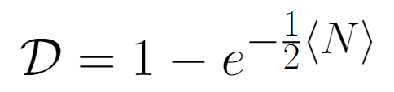
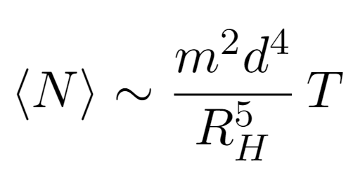
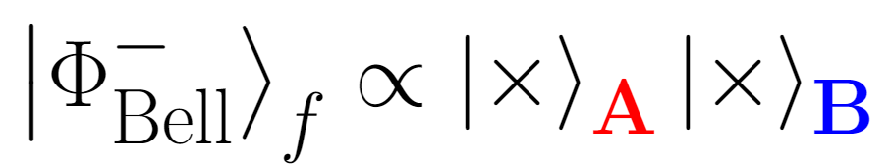


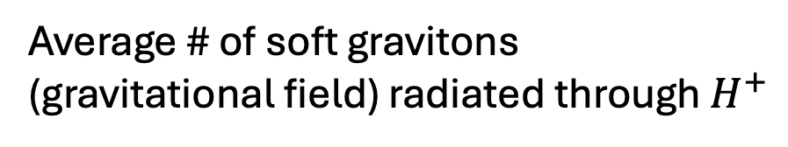
Decohere Quantum Superpositions: Wald approach
$$≡$$
Average # of soft gravitons
(gravitational field) radiated through $H^{+}$
It is shown that this same result applies to Killing horizons
[D. Danielson, G. Satishchandran, R. Wald, arXiv:2301.00026]
The cosmological horizon of de Sitter is a Killing horizon – we take the cosmological horizon to perform the measure and induce a collapse
$$H_{Λ}$$

Slide 51

Elements of a Bell experiment
Measure:
Local choice
$$H_{Λ}$$
Final Observer
Local choice
Imprinting ?
Time
Time

Slide 52
late time observables
Results get classically transmitted to after inflation through horizon-exit and later deceleration of spacetime, which makes fluctuations re-enter.

Slide 53
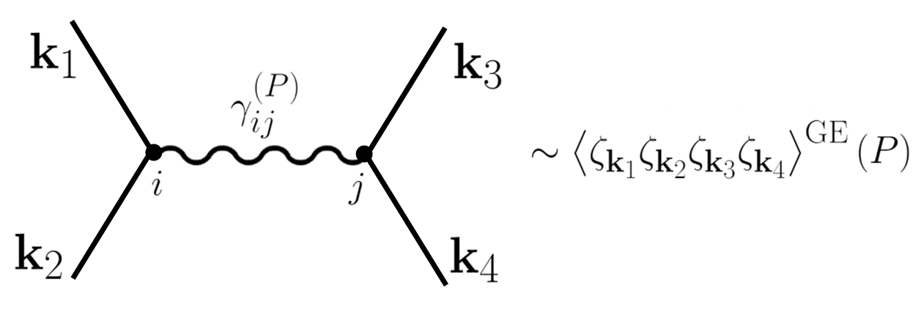
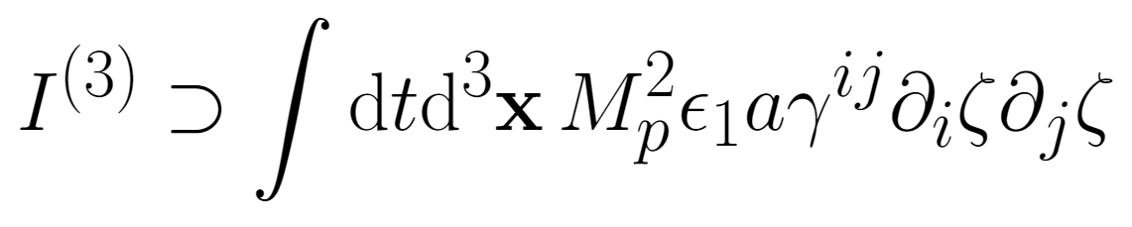


(An alternative way for the measure and) late time observables
Results get classically transmitted to after inflation through horizon-exit and later deceleration of spacetime, which makes fluctuations re-enter. Then:
Time
in
in
An alternative way for the measure
in
$$ij$$
$$ij$$
It can give a measurable signal in the halo bias (in the non-Gaussian part of the 2- and 3-point functions of dark matter halos).
Alice/Bob
out
Additional derivatives may imprint on intrinsic alignment between subhalos in the same patch (i.e. a tidal effect between these two subhalos linked to the polarization of the graviton)

Slide 54








An alternative way for the measure and late time observables
Results get classically transmitted to after inflation through horizon-exit and later deceleration of spacetime, which makes fluctuations re-enter. Then:
Time
Time
Decohere Quantum Superpositions
in
in
$$k_{in}$$
in
or
$γ^{(P)}$(virtual)
$γ^{(P)}$(virtual)
$$ij$$
$$ij$$
Bob
It can give a measurable signal in the halo bias (in the non-Gaussian part of the 2- and 3-point functions of dark matter halos).
Alice
Alice/Bob
out
$$k_{1}$$
$$k_{2}$$
$$k_{3}$$
$$k_{4}$$
Additional derivatives may imprint on intrinsic alignment between subhalos in the same patch (i.e. a tidal effect between these two subhalos linked to the polarization of the graviton)

Slide 55
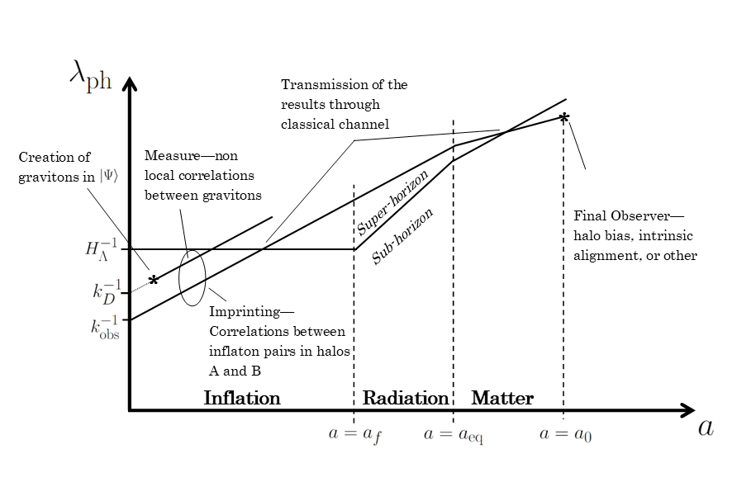
Summary and conclusions (first part)
Mechanism for creation of an entangled state of gravitons in their tensor polarizations from a coherent inflaton field.
19/19

Slide 56
Summary and conclusions (first part)
Mechanism for creation of an entangled state of gravitons in their tensor polarizations from a coherent inflaton field.
Appearance of non-local correlations around the time of horizon crossing due to decoherence from cosmological horizon.
19/19

Slide 57
Summary and conclusions (first part)
Mechanism for creation of an entangled state of gravitons in their tensor polarizations from a coherent inflaton field.
Appearance of non-local correlations around the time of horizon crossing due to decoherence from cosmological horizon.
Construction of a Bell-violating type operator in an inflationary setup, based on the effect of GE on 4-point scalar correlation functions.
19/19

Slide 58
Summary and conclusions (first part)
Mechanism for creation of an entangled state of gravitons in their tensor polarizations from a coherent inflaton field.
Appearance of non-local correlations around the time of horizon crossing due to decoherence from cosmological horizon.
Construction of a Bell-violating type operator in an inflationary setup, based on the effect of GE on 4-point scalar correlation functions.
Suggestion of late-time observables that may carry the imprinting from the 4-point scalar correlation function.
19/19

Slide 59

Inflation without an Inflaton
Project by:
Daniele Bertacca, Raul Jiménez, Sabino Matarrese and Angelo Ricciardone
ArXiv: 2412.14265 in Physical Review

Slide 60
The inflationary paradigm
The inflationary paradigm [see, e.g., Starobinsky (1979, 1980, 1982), Mukhanov & Chibisov (1981), Guth (1981), Linde (1983, 1987), Albrecht and P. J. Steinhardt (1982), Kofman, A. D. Linde and A. A. Starobinsky (1985)] remains the most successful candidate to explain the origin and evolution of the Universe and its large-scale structure [Mukhanov and G. V. Chibisov 1981].
This has led to the search among fundamental particle physics for an inflaton scalar field.

Slide 61

Has there been any definitive theoretical argument leading to a single inflaton candidate? So far, no...
In fact, it is possible to build any inflationary potential, even in fundamental theories, like string theory, that fits the observational data: namely the observed tilt of the spectrum of scalar fluctuations, the upper limit on the energy scale of inflation (the yet to be discovered tensor modes) [see, e.g., Aghanim+ [Planck] (2020) and Galloni+ (2023)] and the non-Gaussian $1−n_{s}$ signature.

Slide 62

Has there been any definitive theoretical argument leading to a single inflaton candidate? So far, no...
In fact, it is possible to build any inflationary potential, even in fundamental theories, like string theory, that fits the observational data: namely the observed tilt of the spectrum of scalar fluctuations, the upper limit on the energy scale of inflation (the yet to be discovered tensor modes) [see, e.g., Aghanim+ [Planck] (2020) and Galloni+ (2023)] and the non-Gaussian $1−n_{s}$ signature.
This is perhaps the main weakness of the inflation paradigm, as it depends on a model-dependent construction.
It is therefore interesting to search for scenarios that are fully model-independent, so that inflation becomes a theory rather than a model.

Slide 63
and… an inflation without the inflaton?
In DB, Jimenez, Matarrese & Ricciardone, 2412.14265, we focus on how scalar perturbations are generated in a model-independent fashion, within a purely quantum physics framework.
We propose a novel scenario in which scalar perturbations, that seed the large-scale structure of the Universe, are generated without relying on a scalar field (the inflaton).

Slide 64
and… an inflation without the inflaton?
In DB, Jimenez, Matarrese & Ricciardone, 2412.14265, we focus on how scalar perturbations are generated in a model-independent fashion, within a purely quantum physics framework.
We propose a novel scenario in which scalar perturbations, that seed the large-scale structure of the Universe, are generated without relying on a scalar field (the inflaton).
In this framework, inflation is driven by a de Sitter space-time (dS), where tensor metric fluctuations (i.e., gravitational waves) naturally arise from quantum vacuum oscillations, and scalar fluctuations are generated via second-order tensor eﬀects

Slide 65
and… an inflation without the inflaton?
In DB, Jimenez, Matarrese & Ricciardone, 2412.14265, we focus on how scalar perturbations are generated in a model-independent fashion, within a purely quantum physics framework.
We propose a novel scenario in which scalar perturbations, that seed the large-scale structure of the Universe, are generated without relying on a scalar field (the inflaton).
In this framework, inflation is driven by a de Sitter space-time (dS), where tensor metric fluctuations (i.e., gravitational waves) naturally arise from quantum vacuum oscillations, and scalar fluctuations are generated via second-order tensor eﬀects
We show that scalar perturbations arise as a second-order eﬀect from tensor perturbations and can become significantly enhanced, allowing them to dominate over the linear tensor modes, which are inherently present in dS.

Slide 66
Generation of second-order scalar modes from tensor perturbations
The generation of these tensor perturbations was first studied in Tomita (1971, 1972) and Matarrese, S. Mollerach and M. Bruni (1998).

Slide 67
Generation of second-order scalar modes from tensor perturbations
The generation of these tensor perturbations was first studied in Tomita (1971, 1972) and Matarrese, S. Mollerach and M. Bruni (1998).
Recently, a quantitative analysis of such tensor-induced scalar perturbations was done in Bari+(2022, 2023) for post-inflationary epochs. Our scenario relies on a similar mechanism to generate the scalar perturbations.

Slide 68
Generation of second-order scalar modes from tensor perturbations
The generation of these tensor perturbations was first studied in Tomita (1971, 1972) and Matarrese, S. Mollerach and M. Bruni (1998).
Recently, a quantitative analysis of such tensor-induced scalar perturbations was done in Bari+(2022, 2023) for post-inflationary epochs. Our scenario relies on a similar mechanism to generate the scalar perturbations.
In addition, the instability of dS space [see, e.g., Mottola (1985), Antoniadis+ (2007), Polyakov (1982, 2007, 2012), Dvali+ (2007, 2014, 2017), Alicki+ (2023a, b)] provides both a natural way for a graceful exit from inflation and also the means to end into a radiation dominated epoch.

Slide 69
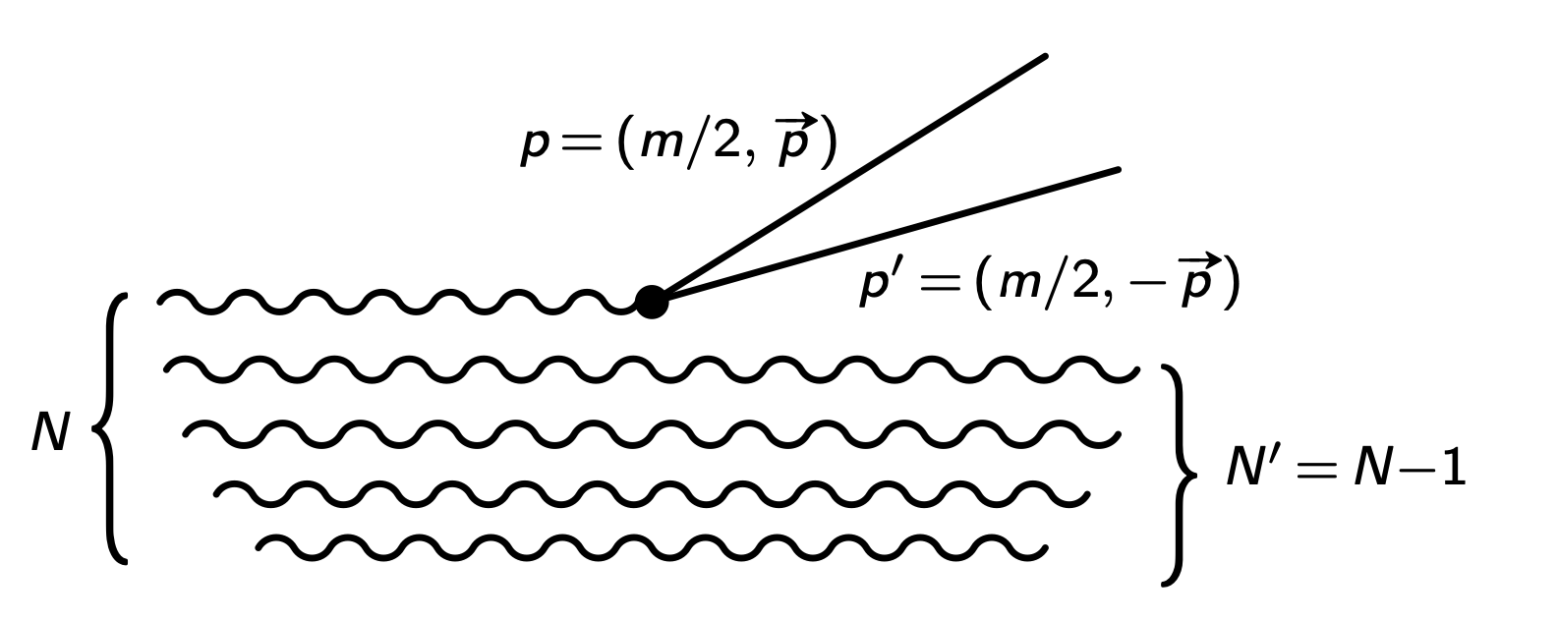
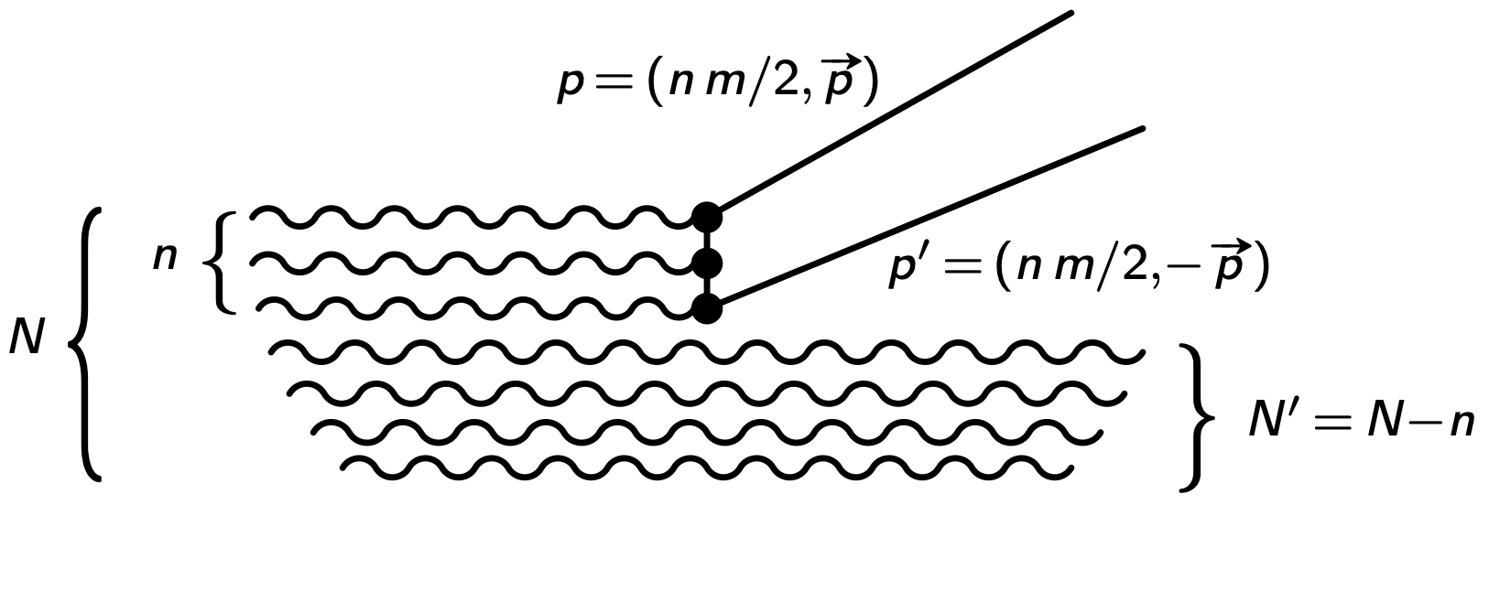
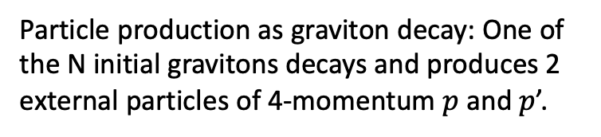
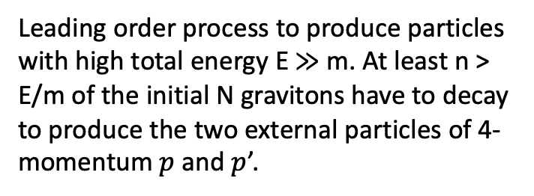
If dS metric as process of scattering and decay of the gravitons: Dvali et al. point of view
As it has been pointed out in Dvali+ (2007, 2014, 2017), if the quantum picture of the dS metric can be described as a Hamiltonian process of scattering and decay of the gravitons composing the coherent state of gravitons, then the self-coupling of gravitons and their coupling with other relativistic particle species leads to metric processes quantum scattering and decay of the constituent gravitons of dS.
Particle production as graviton decay: One of the N initial gravitons decays and produces 2 external particles of 4-momentum $p$ and $p$’.
Leading order process to produce particles with high total energy E ≫ m. At least n > E/m of the initial N gravitons have to decay to produce the two external particles of 4-momentum $p$ and $p$’.

Slide 70
If dS metric as process of scattering and decay of the gravitons: Dvali et al. point of view
As it has been pointed out in Dvali+ (2007, 2014, 2017), if the quantum picture of the dS metric can be described as a Hamiltonian process of scattering and decay of the gravitons composing the coherent state of gravitons, then the self-coupling of gravitons and their coupling with other relativistic particle species leads to metric processes quantum scattering and decay of the constituent gravitons of dS.
Particle production as graviton decay: One of the N initial gravitons decays and produces 2 external particles of 4-momentum $p$ and $p$’.
Leading order process to produce particles with high total energy E ≫ m. At least n > E/m of the initial N gravitons have to decay to produce the two external particles of 4-momentum $p$ and $p$’.

Slide 71
If dS metric as process of scattering and decay of the gravitons: Dvali et al. point of view
As it has been pointed out in Dvali+ (2007, 2014, 2017), if the quantum picture of the dS metric can be described as a Hamiltonian process of scattering and decay of the gravitons composing the coherent state of gravitons, then the self-coupling of gravitons and their coupling with other relativistic particle species leads to metric processes quantum scattering and decay of the constituent gravitons of dS.
In Dvali+ 2017 they called it as a “Quantum Break-Time of de Sitter of a system ” and it is the time-scale after which its true quantum evolution departs from the classical mean field evolution.
Particle production as graviton decay: One of the N initial gravitons decays and produces 2 external particles of 4-momentum $p$ and $p$’.
Leading order process to produce particles with high total energy E ≫ m. At least n > E/m of the initial N gravitons have to decay to produce the two external particles of 4-momentum $p$ and $p$’.

Slide 72
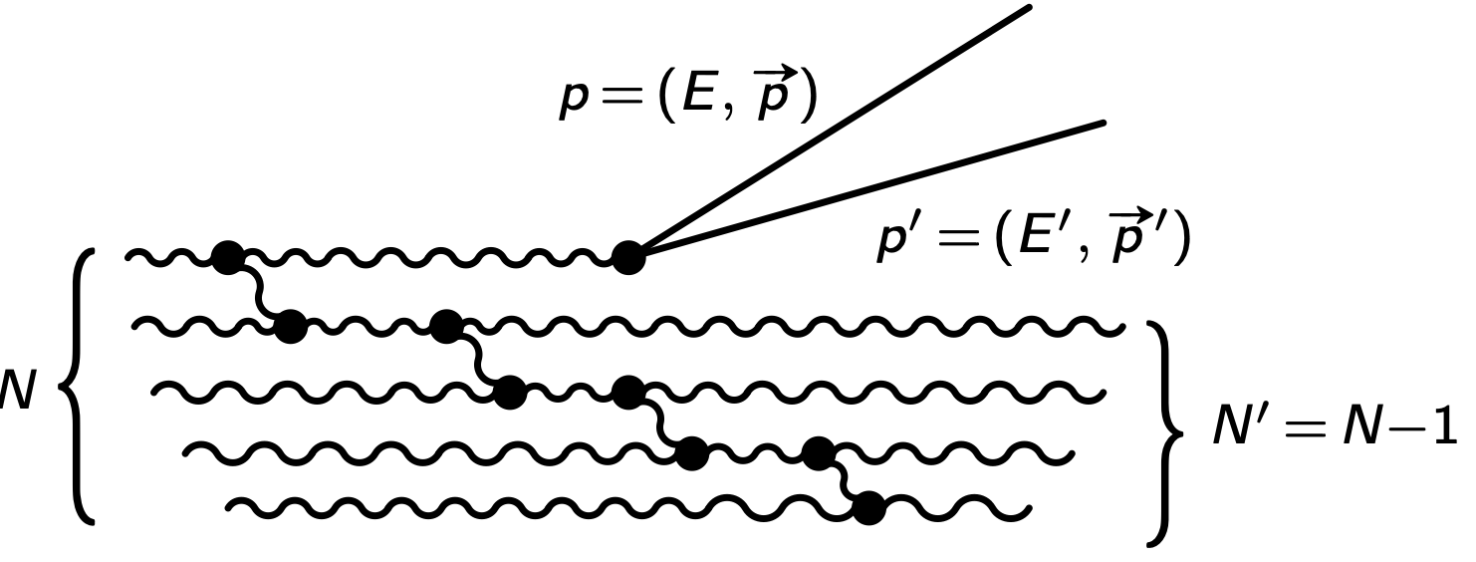
If dS metric as process of scattering and decay of the gravitons: Dvali et al. point of view
Let me precise the last point:
If one describes dS as a quantum coherent state composite of gravitons, then the self-coupling of gravitons— as well as their coupling to other relativistic particle species, such as those in the Standard Model (SM), which must always be present—leads to quantum scattering and decay of the constituent gravitons of dS.
Higher order process of particle production, in which the produced particles recoil against all remaining gravitons. In particular, this allows for produced particles of low energies E, E′ ≪ m/2.

Slide 73
If dS metric as process of scattering and decay of the gravitons: Dvali et al. point of view
Let me precise the last point:
If one describes dS as a quantum coherent state composite of gravitons, then the self-coupling of gravitons— as well as their coupling to other relativistic particle species, such as those in the Standard Model (SM), which must always be present—leads to quantum scattering and decay of the constituent gravitons of dS.
Higher order process of particle production, in which the produced particles recoil against all remaining gravitons. In particular, this allows for produced particles of low energies E, E′ ≪ m/2.

Slide 74
If dS metric as process of scattering and decay of the gravitons: Dvali et al. point of view
Let me precise the last point:
If one describes dS as a quantum coherent state composite of gravitons, then the self-coupling of gravitons— as well as their coupling to other relativistic particle species, such as those in the Standard Model (SM), which must always be present—leads to quantum scattering and decay of the constituent gravitons of dS.
In this case, the final quantum state cannot be described as a coherent state, and there will no longer be the dispersion relations of the free quanta propagating on a classical dS background.
Higher order process of particle production, in which the produced particles recoil against all remaining gravitons. In particular, this allows for produced particles of low energies E, E′ ≪ m/2.

Slide 75
Instability of dS? [Mottola point of view]
As Antoniadis+ (2007) points out, based on particle creation Mottola (1985) and the fluctuation-dissipation theorem Mottola (1986a) or, equivalently, on thermodynamic considerations Mottola (1986b), dS spacetime is unstable and the time scale of this instability can be exponentially large given any initial perturbation.

Slide 76
Instability of dS? [Mottola point of view]
As Antoniadis+ (2007) points out, based on particle creation Mottola (1985) and the fluctuation-dissipation theorem Mottola (1986a) or, equivalently, on thermodynamic considerations Mottola (1986b), dS spacetime is unstable and the time scale of this instability can be exponentially large given any initial perturbation.
This occurs because the geometry of the gravitational field is coupled to the energy-momentum stress tensor and this quantity, in turn, governs the dynamics of the gravitational field.
Consequently, the quantum fluctuations of the vacuum or, equivalently, the effects of particle creation are linked to a background gravitational field.

Slide 77
Instability of dS: singular behavior for low frequencies [Mottola point of view]
By analyzing the polarization function corresponding to the perturbations in scalar/metric traces of the de Sitter background, the fluctuations of quantum matter possess a spectrum with a singular behavior for low frequencies Mottola (1985).
[Note that this describes a system response to perturbations on length scales of the order of the horizon size or larger. ]

Slide 78
Instability of dS: singular behavior for low frequencies [Mottola point of view]
By analyzing the polarization function corresponding to the perturbations in scalar/metric traces of the de Sitter background, the fluctuations of quantum matter possess a spectrum with a singular behavior for low frequencies Mottola (1985).
[Note that this describes a system response to perturbations on length scales of the order of the horizon size or larger. ]
Then, due to this infrared phenomena a classically stable dS background becomes unstable due to quantum fluctuations and the system will decay towards a final state in which the classical field energy can, on average, be described in matter or radiation field modes.

Slide 79
Instability of dS: singular behavior for low frequencies [Mottola point of view]
By analyzing the polarization function corresponding to the perturbations in scalar/metric traces of the de Sitter background, the fluctuations of quantum matter possess a spectrum with a singular behavior for low frequencies Mottola (1985).
[Note that this describes a system response to perturbations on length scales of the order of the horizon size or larger. ]
Then, due to this infrared phenomena a classically stable dS background becomes unstable due to quantum fluctuations and the system will decay towards a final state in which the classical field energy can, on average, be described in matter or radiation field modes.

Slide 80
Instability of dS: singular behavior for low frequencies [Mottola point of view]
Therefore, quantum infrared effects in dS space might suggest a dynamic relaxation mechanism, see Mottola (1986a).

Slide 81
Instability of dS: singular behavior for low frequencies [Mottola point of view]
Therefore, quantum infrared effects in dS space might suggest a dynamic relaxation mechanism, see Mottola (1986a).
Then, low frequency divergence determines the particle creation rate in the adiabatic limit of slowly varying backgrounds, and, at the same time, this singular behavior means that the background is unstable to small perturbations.
This, indeed, is the typical signal due to the spontaneous breaking of the time reversal symmetry [see Antoniadis+ (2007)].
If we are initially in a de Sitter spacetime, the coherent vacuum energy converts into matter/radiation mode on the time scales relevant to cosmology.

Slide 82
Instability of dS: thermodynamic considerations [Mottola point of view]
If we use thermodynamic considerations, see Mottola (1986b), we note that the existence of such a maximally symmetric state cannot guarantee stability against small fluctuations.

Slide 83
Instability of dS: thermodynamic considerations [Mottola point of view]
If we use thermodynamic considerations, see Mottola (1986b), we note that the existence of such a maximally symmetric state cannot guarantee stability against small fluctuations.
Indeed, considering a small fluctuation in the Hawking temperature of the horizon which (as in the case of the black hole) this causes a small net heat exchange between the inner region and the horizon and its surroundings.

Slide 84
Instability of dS: thermodynamic considerations [Mottola point of view]
If we use thermodynamic considerations, see Mottola (1986b), we note that the existence of such a maximally symmetric state cannot guarantee stability against small fluctuations.
Indeed, considering a small fluctuation in the Hawking temperature of the horizon which (as in the case of the black hole) this causes a small net heat exchange between the inner region and the horizon and its surroundings.
This leads to having a system with negative heat capacity always between the internal region and the horizon.

Slide 85
Instability of dS: thermodynamic considerations [Mottola point of view]
This negative heat capacity highlights the impossibility of a stable system in thermodynamic equilibrium and corresponds to an out-of-control process in which any infinitesimal heat exchange between the regions inside and outside the horizon further distances the system from its equilibrium configuration.

Slide 86
Instability of dS: thermodynamic considerations [Mottola point of view]
This negative heat capacity highlights the impossibility of a stable system in thermodynamic equilibrium and corresponds to an out-of-control process in which any infinitesimal heat exchange between the regions inside and outside the horizon further distances the system from its equilibrium configuration.
The entire space is unstable to quantum/thermal fluctuations in its Hawking temperature, nucleating a sort of vacuum bubble at an arbitrary point, breaking global dS invariance, see Mottola (1986b).

Slide 87
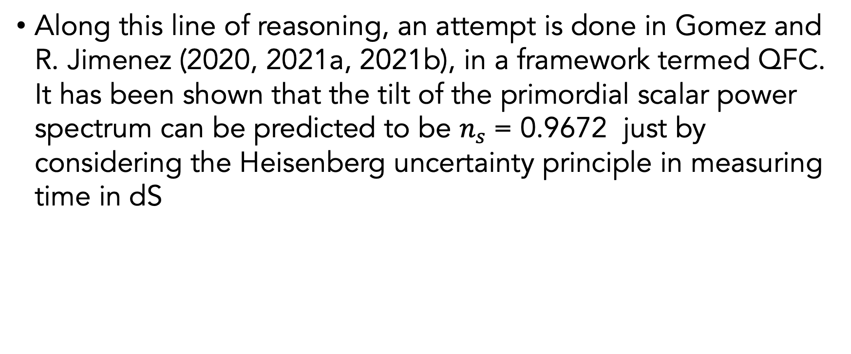
E.g., Quantum Fisher Cosmology (QFC)
Along this line of reasoning, an attempt is done in Gomez and R. Jimenez (2020, 2021a, 2021b), in a framework termed QFC. It has been shown that the tilt of the primordial scalar power spectrum can be predicted to be $n_{s}$= 0.9672 just by considering the Heisenberg uncertainty principle in measuring time in dS

Slide 88
Instability of dS - thermodynamic considerations: Alicki point of view
In Alicki+ (2023a, b)] using an approach related to quantum thermodynamics:
- they provide a natural mechanism for the irreversible relaxation of the cosmological constant,
- and dS decay, in order to escape the inflationary epoch, without the need for subsequent reheating, and
- suggest an alternative way to generate the primordial perturbations which could arise from the thermal fluctuations described by the power spectrum.

Slide 89
About perturbations?

Slide 90
About perturbations?
In DB, Jimenez, Matarrese & Ricciardone, 2412.14265 we introduce a novel mechanism where we derive the exact expressions for the second-order scalar potentials and the scalar power spectrum resulting from second-order tensor perturbations.
We demonstrate that the latter agrees with the expected nearly scale-invariance from observations, opening the way for numerous potential follow-up studies and extensions.
Note that here the considered fluid unavoidably arises from the vacuum expectation value of the second-order contribution to the Einstein’s tensor from gravitational waves (GW), which on sub-horizon scales leads to non-vanishing energy, pressure and anisotropic stress (this point is raised also in Dvali + 2013!!).

Slide 91
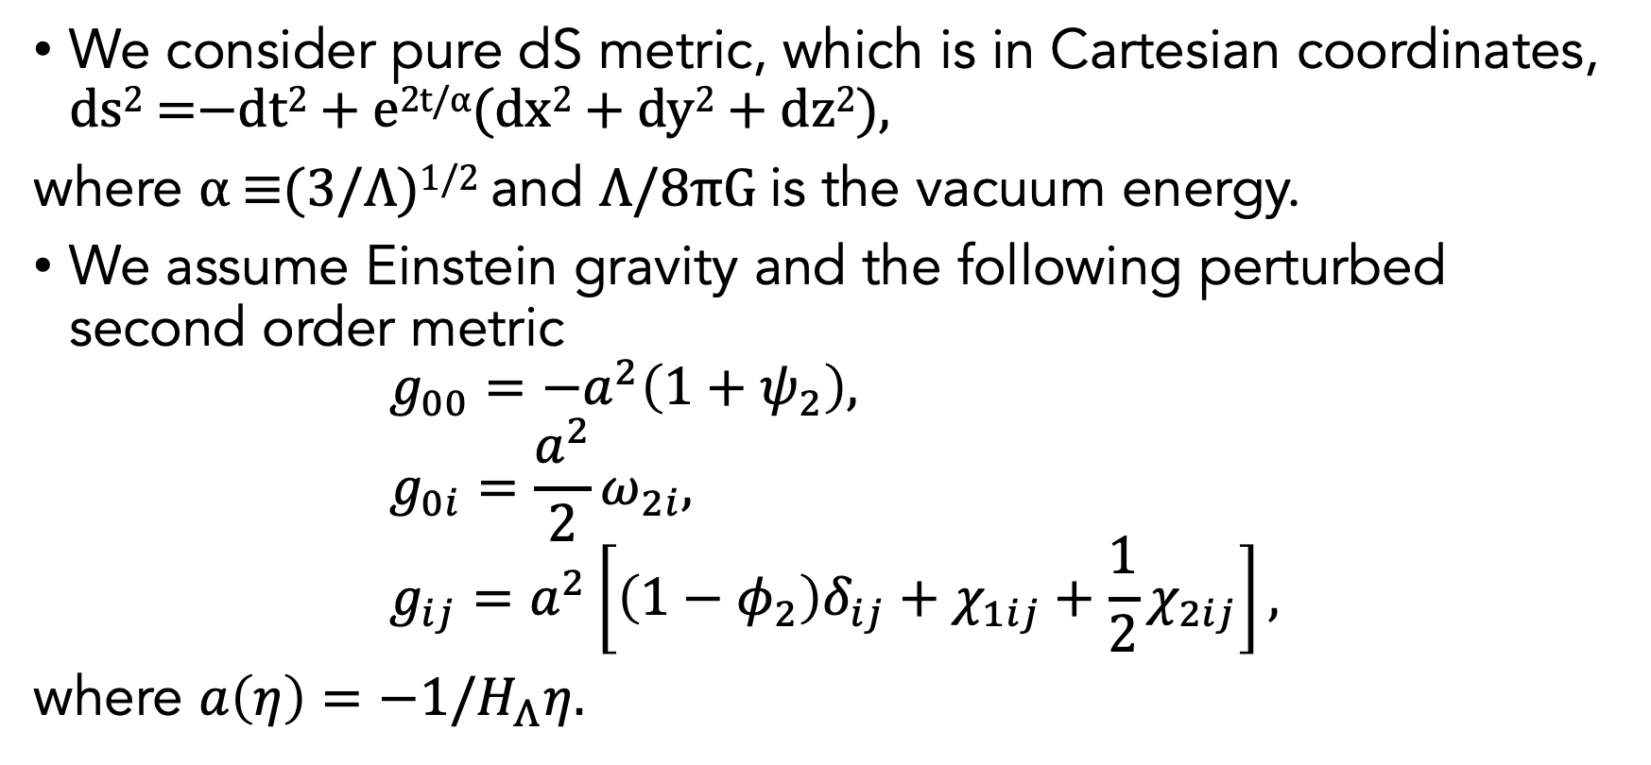
SCALAR PERTURBATIONS FROM TENSOR MODES
We consider pure dS metric, which is in Cartesian coordinates, ds² =−dt² + e^{2t/α}(dx² + dy² + dz²),
where α ≡(3/Λ)^{1/2} and Λ/8πG is the vacuum energy.
We assume Einstein gravity and the following perturbed second order metric
$$g_{00}=−a^{2}\left(1+ψ_{2}\right), \\ g_{0i}=\frac{a^{2}}{2}ω_{2i}, \\ g_{ij}=a^{2}\left[\left(1−φ_{2}\right)δ_{ij}+χ_{1ij}+\frac{1}{2}χ_{2ij}\right],$$
where $a\left(η\right)=−1/H_{Λ}η$.

Slide 92

Now a first question that we can make…
Unless the "background" vacuum energy (by Mottola et al.) or coherent states (by Dvali et al.) Λ/8πG and if we exclude any (perturbative) contributions on the right-hand side of Einstein's equations, is it possible to obtain solutions for, e.g., $ψ_{2}$ and $φ_{2}$, which depend only on $χ_{1ij}$?
The answer is…

Slide 93
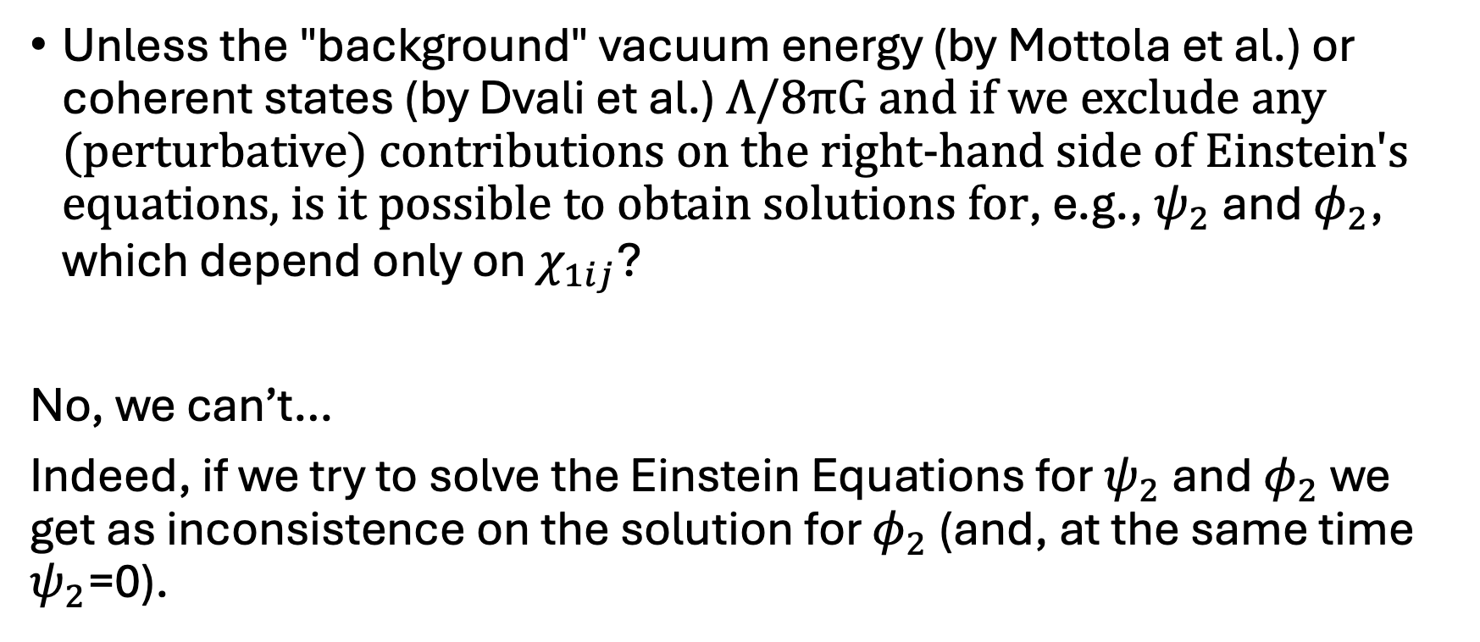
Now a first question that we can make…
Unless the "background" vacuum energy (by Mottola et al.) or coherent states (by Dvali et al.) Λ/8πG and if we exclude any (perturbative) contributions on the right-hand side of Einstein's equations, is it possible to obtain solutions for, e.g., $ψ_{2}$ and $φ_{2}$, which depend only on $χ_{1ij}$?
No, we can’t…
Indeed, if we try to solve the Einstein Equations for $ψ_{2}$ and $φ_{2}$ we get as inconsistence on the solution for $φ_{2}$ (and, at the same time $ψ_{2}$=0).

Slide 94



SCALAR PERTURBATIONS FROM TENSOR MODES
For generality, on the RHS of Einstein’s equations, we allow for the presence of a stress-energy tensor which accounts for the sum of the cosmological constant driving our dS expansion plus a generic fluid, with energy density ρ, isotropic pressure $p$, four-velocity $u^{μ}$ and anisotropic stress tensor $π_{ν}^{μ}$, namely
.

Slide 95

SCALAR PERTURBATIONS FROM TENSOR MODES
For generality, on the RHS of Einstein’s equations, we allow for the presence of a stress-energy tensor which accounts for the sum of the cosmological constant driving our dS expansion plus a generic fluid, with energy density ρ, isotropic pressure $p$, four-velocity $u^{μ}$ and anisotropic stress tensor $π_{ν}^{μ}$, namely
.
NOTE: by using the idea by Dvali et al 2013 and 2017 this seemingly-classical system quantum mechanically as the mixture of the two “Bose-gases”:
the quantum coherent state that describes $Λ$;
a cosmological fluid that plays the role of a cosmic clock! Precisely, this compositeness acts as a quantum clock (that becomes classical at scales larger than horizon) that imprints measurable eﬀects into cosmological observables.
These eﬀects are cumulative and gather the information throughout the entire duration of inflation.

Slide 96



SCALAR PERTURBATIONS FROM TENSOR MODES
Considering only the tensor contribution we have, in the comoving frame of such a GW fluid,
from which we can compute $u_{μ}$ as:

Slide 97



SCALAR PERTURBATIONS FROM TENSOR MODES
For the 00 component at second order, we find
.
The other components of $T_{ν}^{μ}$ are given by
where $\overline{ρ}$ and $w$ are, respectively, the energy density and the equation of state at the background level.
We split the peculiar velocity $v_{2i}$= $v_{2,i}+v_{\text{⊥}2i}$as, where $v_{\text{⊥}2i}$ is a solenoidal (divergence-free or transverse) vector.

Slide 98


SCALAR PERTURBATIONS FROM TENSOR MODES
The anisotropic stress tensor can be decomposed into a trace-free scalar part, $Π$ , a vector part, $Π_{i}$, and a tensor part, $Π_{ij}$, at each order according to
.

Slide 99




Equation for $φ_{2}$
Considering a graviton perturbation, with generic $w$ and $c_{s}$cs, where $δ^{2}p=c_{s}^{2}δ^{2}ρ$ and manipulating the Einstein equations, we find the Master Equation for $φ_{2}$
where

Slide 100





Equation for $ψ_{2}$
Using the traceless part of the ij components we find
where
and, considering only the tensor contribution, the gauge-invariant curvature perturbation on uniform density hyper-
surfaces is
Then using the energy constraint equation we get
.

Slide 101



Focusing only modes larger than the horizon…
Focusing only modes larger than the horizon, neglecting terms that contain $χ_{1kj}′$, and considering only terms with total number of spatial derivatives equal (or less) than zero, we find
where we set, in de Sitter Universe, $H=H_{Λ}$ is constant and $ℋ^{′}=ℋ^{2}$, $η=−\exp\left[{−H}_{Λ}t\right]/H_{Λ}$, i.e. $a\left(η\right)=−1/H_{Λ}η$ and $ℋ=−1/η$.

Slide 102





Focusing modes larger than the horizon for $φ_{2}$ is const.
In this case we need an extra relation to close the equations and find a general solution.
Un possible way is to look at the particular solution in which $φ_{2}$ is constant on very large scales. In this case we get
and let us write the traceless part as
and combine them we find
.

Slide 103



Focusing modes larger than the horizon for $φ_{2}$ is const.
Then using the energy-momentum constraint equation we get
We can quickly verify that the previous two equations can be combined again to recover the usual relation

Slide 104



For $φ_{2}$ is const., is it possible to have $ψ_{2}≠0$?
These relations
and
suggest that if
we have $ψ_{2}=0$ when $φ_{2}=ℱ_{χ}/4$.
Let us point out that $ψ_{2}=0$ on very large scales is a possible solution but it is not sufficient if we want to promote these solutions to those describing the scalar primordial power spectrum.

Slide 105

A comment:
As can be seen from the metrics we have considered, with our approach we can analytically study vectors and tensors at the second order.
These contributions will also be analysed in detail in a subsequent paper.

Slide 106


When $ψ_{2}=0$ and $φ_{2}=ℱ_{χ}/4$
Let me focus only on the first terms in
then we have
where

Slide 107



For $φ_{2}$ is const., is it possible to have $ψ_{2}≠0$?
For $ψ_{2}≠0$ we can say more…
1) when $ψ_{2}≠0 , ψ_{2}$ is not constant!
2) … and what about $ζ$ ? What can we say?
… or let me rephrase with other questions…
This results show how the second-order scalar fluctuation grows as kη → 0 and thus, dominates over the tensor modes.
In this set up the curvature perturbation does not stay constant, which is a crucial property of this variable $ζ?$
What is the justification for not having constant $ζ$ ?
Why does the elimination of this characteristic not matter in this case?

Slide 108
For $φ_{2}$ is const., is it possible to have $ψ_{2}≠0$?
For $ψ_{2}≠0$ we can say more…
1) when $ψ_{2}≠0 , ψ_{2}$ is not constant!
2) … and what about $ζ$ ? What can we say?
Possible answer(s):
This effect is very important (for the framework we are considering in this paper) to obtain at the end of inflation an amplitude for the power spectrum of P_{ζ} that is larger than the tensor one.
This is a specific feature of our scenario, which allows us to reach constraints imposed, for instance, at CMB scales. Otherwise, we are not able to reach the constraint imposed, for example, by CMB measurements. As for the smallest (comoving) scales, they should be very small compared to the (comoving) cosmological horizon.
Of course, there are several non-trivial effects that can be directly observed via Master equation that we have obtained.

Slide 109

For $φ_{2}$ is const., is it possible to have $ψ_{2}≠0$?
For $ψ_{2}≠0$ we can say more…
1) when $ψ_{2}≠0 , ψ_{2}$ is not constant!
2) … and what about $ζ$ ? What can we say?
Note that the non-constant part of $ζ$ is CRUCIAL if we want to measure quantum mechanics effects!
Indeed, in this case, during the inflation epoch
$$\left[ζ_{\vec{k}},{\dot{ζ}}_{−\vec{k}}\right]≠0‼!$$
See also the discussion made in Madalcena (2015)
E.g. via a similar prescription made in the first part of the talk!

Slide 110


For $φ_{2}$ is const., is it possible to have $ψ_{2}≠0$?
Note that here, $η_{in}$ is a suitable initial time in which the hypothesis that $φ_{2}$ is const., i.e on very large scale (where our hypothesis is correct).
Then, considering just a mode with a given comoving $k$, we know that this assumption is reasonably correct just after horizon crossing.
Then $η_{in}$ must depend on comoving $k$ (i.e., for diﬀerent k we should have a suitable $η_{in}$). In this case, as
a first approximation, we can set $\left|η_{in}(k)\right|≈1/c_{s}k$.
Therefore, if we Fourier transform all these variables we obtain

Slide 111



For $φ_{2}$ is const., is it possible to have $ψ_{2}≠0$?
At super-horizon scales, still assuming $φ_{2}$ is const. , where we left $w$ and $c_{s}$ generic
for $ζ_{2}$ we find
Now we need to know the value of $c_{s}$ and ${\overline{ρ}}_{in}$ at a given mode $k$.
It is transparent that
$$w−c_{s}^{2}>0$$
for the scalar fluctuations to be larger than the tensor ones. This can be achieved by the same gravitons produced during de Sitter phase. For this particle (fluid) radiation, the scalar perturbations will no longer grow [Dvali + 2013, 2017].
This provides a natural route to end inflation!

Slide 112
About Rehating
At a usual end of inflation, however it came to be, there must be some reheating process which repopulates the observable patch with the standard model matter. In this scenario, the reheating is gravity mediated (since there is no scalar field to couple to the SM).
Instead, in our scenario, particle production is produced by de Sitter decaying into radiation as postulated in the Mottola, Polyakov, Dvali works...
This out-of-equilbrium transition to a radiation phase is what provides a replenishment of the patch with SM particles. We can use Kolb & Turner book to be more quantitative. For out of equilibrium decay TRH = 10⁻¹⁰(E/GeV )^{3/2} GeV, where E is the scale of inflation. Using the value derived from the level of CMB fluctuations (10¹⁴⁻¹⁵ GeV) leads to 10¹¹ < T_{RH}/GeV < 10¹², which allows for baryogenesis, and it is below the current CMB limits on the energy scale of inflation.
This will result in a particle density of 10⁹⁰ < n_{χ} < 10¹⁰⁰, perfectly consistent with the current number of particles in the horizon of 1090 and entropy generated out of equilibrium between 1−3 (S_{f} /S_{i} = 10⁷(E/GeV )^{−1/2}), which guarantees no extra injection of entropy.

Slide 113

Some final comments (1):
The power spectrum is nearly scaling invariant;
We have shown that it is possible to generate nearly scale-invariant scalar adiabatic perturbations in pure de Sitter.
This is a scenario where the inflaton does not exist, and thus opens up the possibility to provide a picture of inflation that is model independent.

Slide 114

Some final comments (2):
There are some interesting features in our calculation. First, note that the
- scalar fluctuations are generated outside the horizon from the tensor perturbations. Assuming these fluctuations are adiabatic, as in the standard picture of inflation, the perturbations induced in the potential $φ$ persist after the transition from the dS phase to a radiation dominated epoch through the decay of dS.
- Similarly to scalar modes, vector perturbations are also generated from second order tensor fluctuations.
- As expected, the fluctuations deviate from Gaussianity and exhibit a certain intrinsic level of non-Gaussian features, the quantification of which will be addressed in a future publication.

Slide 115
Some comments (3):
However, we note the following: for any non-conformally invariant field (with mass m≪H) the quantum generation of particles from the vacuum state (or quantum depletion of the Bose-Einstein condensate, see Dvali et al.) will add extra contributions to the second-order scalar perturbation mode, hence contributing to a gaussianization by the central limit theorem (see also the point of Dvali et al.).
In our scenario, the magnitude of fluctuations which rely exclusively on dS features and potential physical mechanisms that enhance scalar perturbations.
These factors suggest a possible explanation for why the fluctuations are at the 10⁻⁵ level.

Slide 116





Working progress…
Marisol Traforetti
PhD student at ICC Barcelona
Mariam Abdelaziz
PhD student in SSM Naples
She is completing the account with the full kernel and is calculating the power spectrum on larger scales equal to the horizon until the end of inflation.
She is also calculating bispectrum with a view to a more in-depth study of Non-Gaussianity for this type of model.

Slide 117
BACKUPS

Slide 118
BACKUPS
First part

Slide 119





Measure/Decoherence by the Cosmological Horizon
[R. Wald, Killing Horizons decohere quantum superpositions]
$$i^{+}$$
$$H^{+}$$
$${\text{J}}^{ +}$$
$$i^{0}$$
$$i^{−}$$

Slide 120










$$i^{+}$$
$$H^{+}$$
$${\text{J}}^{ +}$$
$×$
$×$
$$i^{0}$$
$+ ×$
$+ ×$
Initially in a superposition between $+, ×$ polarizations

Slide 121
$$i^{+}$$
Non-local correlations on polarization of gravitons A and B
$$H^{+}$$
$${\text{J}}^{ +}$$
$×$
$×$
$$i^{0}$$
$+ ×$
$+ ×$
10/19

Slide 122


$$i^{+}$$
Non-local correlations on polarization of gravitons A and B
$$≡$$
$$H^{+}$$
Average # of soft gravitons
(gravitational field) radiated through $H^{+}$
$${\text{J}}^{ +}$$
$×$
$×$
$$i^{0}$$
$+ ×$
$+ ×$

Slide 123


$$≡$$
Average # of soft gravitons
(gravitational field) radiated through $H^{+}$
It is shown that this same result applies to Killing horizons
[D. Danielson, G. Satishchandran, R. Wald, arXiv:2301.00026]
The cosmological horizon of de Sitter is a Killing horizon – we take the cosmological horizon to perform the measure and induce a collapse
$$H_{Λ}$$

Slide 124
Elements of a Bell experiment
Measure:
Local choice
$$H_{Λ}$$
Final Observer
Local choice
Imprinting ?

Slide 125
Late time observables
Results get classically transmitted to after inflation through horizon-exit and later deceleration of spacetime, which makes fluctuations re-enter. Then:
can give a measurable signal in the halo bias (in the non-Gaussian part of the 2- and 3-point functions of dark matter halos).
: Additional derivatives may imprint
on intrinsic alignment between subhalos in the same patch (i.e. a tidal effect between these two subhalos linked to the polarization of the graviton)

Slide 126




Back del Bakup della prima parte
$$k_{in}$$
Alice
Bob
$$k_{1}$$
$$k_{2}$$
$$k_{3}$$
$$k_{4}$$

Slide 127
Imprinting by Graviton Exchange (GE)

Slide 128



Imprinting by Graviton Exchange (GE)
This interaction is sensitive to the polarization of the graviton(s).
The collapse reduces the sum to 1 term only .

Slide 129










Imprinting by Graviton Exchange (GE)
$$φ_{1}$$
$$φ_{3}$$
$$A(φ_{1})$$
$$B(φ_{3})$$
$$k_{12}$$
$$θ_{1}$$
$$k_{1}$$
$$e$$
$$\overline{e}$$
$$φ_{1}$$

Slide 130





Bell observable $S^{QM}$
$$S^{QM}=\left\langle A(φ_{1})B(φ_{3}) \right\rangle +\left\langle A(φ_{1}′)B(φ_{3}) \right\rangle +\left\langle A(φ_{1})B(φ_{3}′) \right\rangle −\left\langle A(φ_{1}′)B(φ_{3}′) \right\rangle$$
since:
, and

Slide 131


Bell observable $S^{QM}$
$$S^{QM}=\left\langle A(φ_{1})B(φ_{3}) \right\rangle +\left\langle A(φ_{1}′)B(φ_{3}) \right\rangle +\left\langle A(φ_{1})B(φ_{3}′) \right\rangle −\left\langle A(φ_{1}′)B(φ_{3}′) \right\rangle$$
$$∝$$
A
B
A’
B
A
B’
A’
B’
Interpretation?
15/19

Slide 132





Bell observable $S^{QM}$
$$S^{QM}=\left\langle A(φ_{1})B(φ_{3}) \right\rangle +\left\langle A(φ_{1}′)B(φ_{3}) \right\rangle +\left\langle A(φ_{1})B(φ_{3}′) \right\rangle −\left\langle A(φ_{1}′)B(φ_{3}′) \right\rangle$$
The momentum of the exchanged graviton will set the distance (inverse) between the 2 halos A and B
Halo B
Halo A

Slide 133

Bell observable $S^{QM}$
$$S^{QM}=\left\langle A(φ_{1})B(φ_{3}) \right\rangle +\left\langle A(φ_{1}′)B(φ_{3}) \right\rangle +\left\langle A(φ_{1})B(φ_{3}′) \right\rangle −\left\langle A(φ_{1}′)B(φ_{3}′) \right\rangle$$
Halo B
’
Halo A
’

Slide 134

Bell observable $S^{QM}$
$$S^{QM}=\left\langle A(φ_{1})B(φ_{3}) \right\rangle +\left\langle A(φ_{1}′)B(φ_{3}) \right\rangle +\left\langle A(φ_{1})B(φ_{3}′) \right\rangle −\left\langle A(φ_{1}′)B(φ_{3}′) \right\rangle$$
Halo B
’
Halo A
’

Slide 135
Elements of a Bell experiment
Measure:
Local choice
$$H_{Λ}$$
?
Final Observer
Local choice
Imprinting

Slide 136
Bell Experiment and Inequalities

Slide 137


Hamiltonian for creation of entangled state

Slide 138




Creation of entangled state – Schrödinger’sº Equation
Parametric approximation:
Interaction picture:
Expanding the evolution operator:

Slide 139



Decoherence by Killing horizon
$$≡$$
Average # of soft gravitons (gravitational field) radiated through $H^{+}$
For Killing horizons:
Time of decoherence compared to time scale of GE:

Slide 140

More on GE and Observable definition
;
$$k_{12}$$
$$θ_{1}$$
$$k_{1}$$
$$e$$
$$\overline{e}$$
$$φ_{1}$$

Slide 141






More on Bell Inequiality Violation
for
$$+$$
for
$$⇒$$

Slide 142


More specifications of $S^{QM}$

Slide 143
BACKUPS
Second PART

Slide 144


Slide 145


